Slide 1
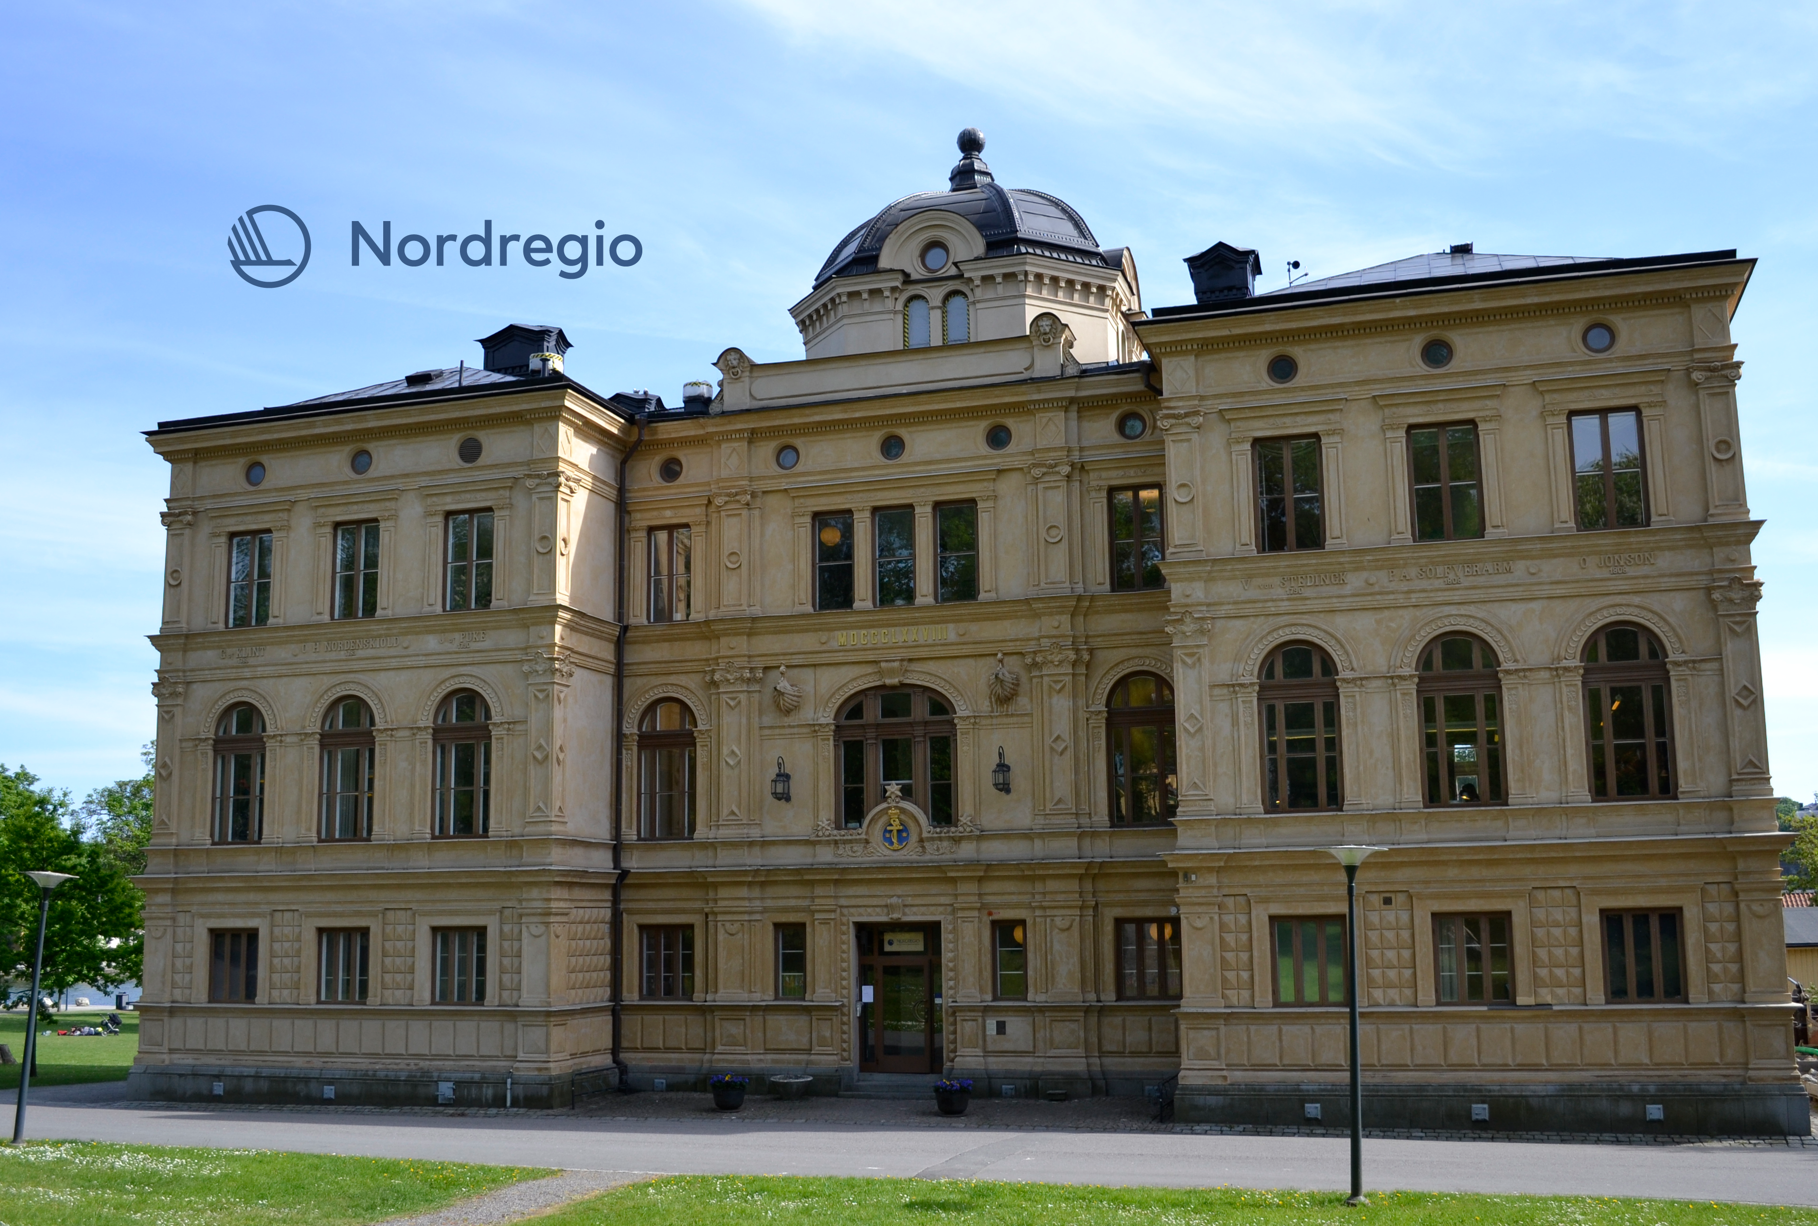
Global goals for local priorities
Nordregio’s work with the 2030 Agenda
Nora Sánchez Gassen (nora.sanchezgassen@nordregio.org)

Slide 2
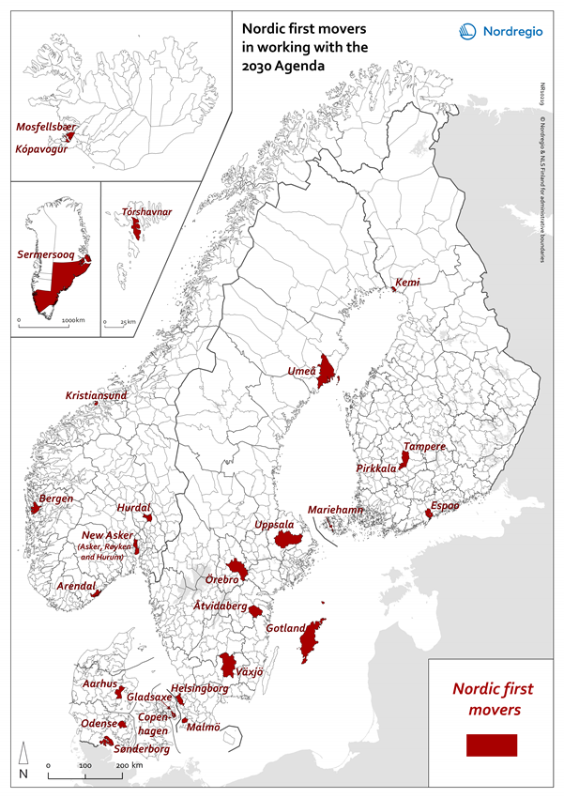
Mapping of good practices across the Nordics
Link to report: http://norden.diva-portal.org/smash/get/diva2:1251563/FULLTEXT03.pdf

Slide 3
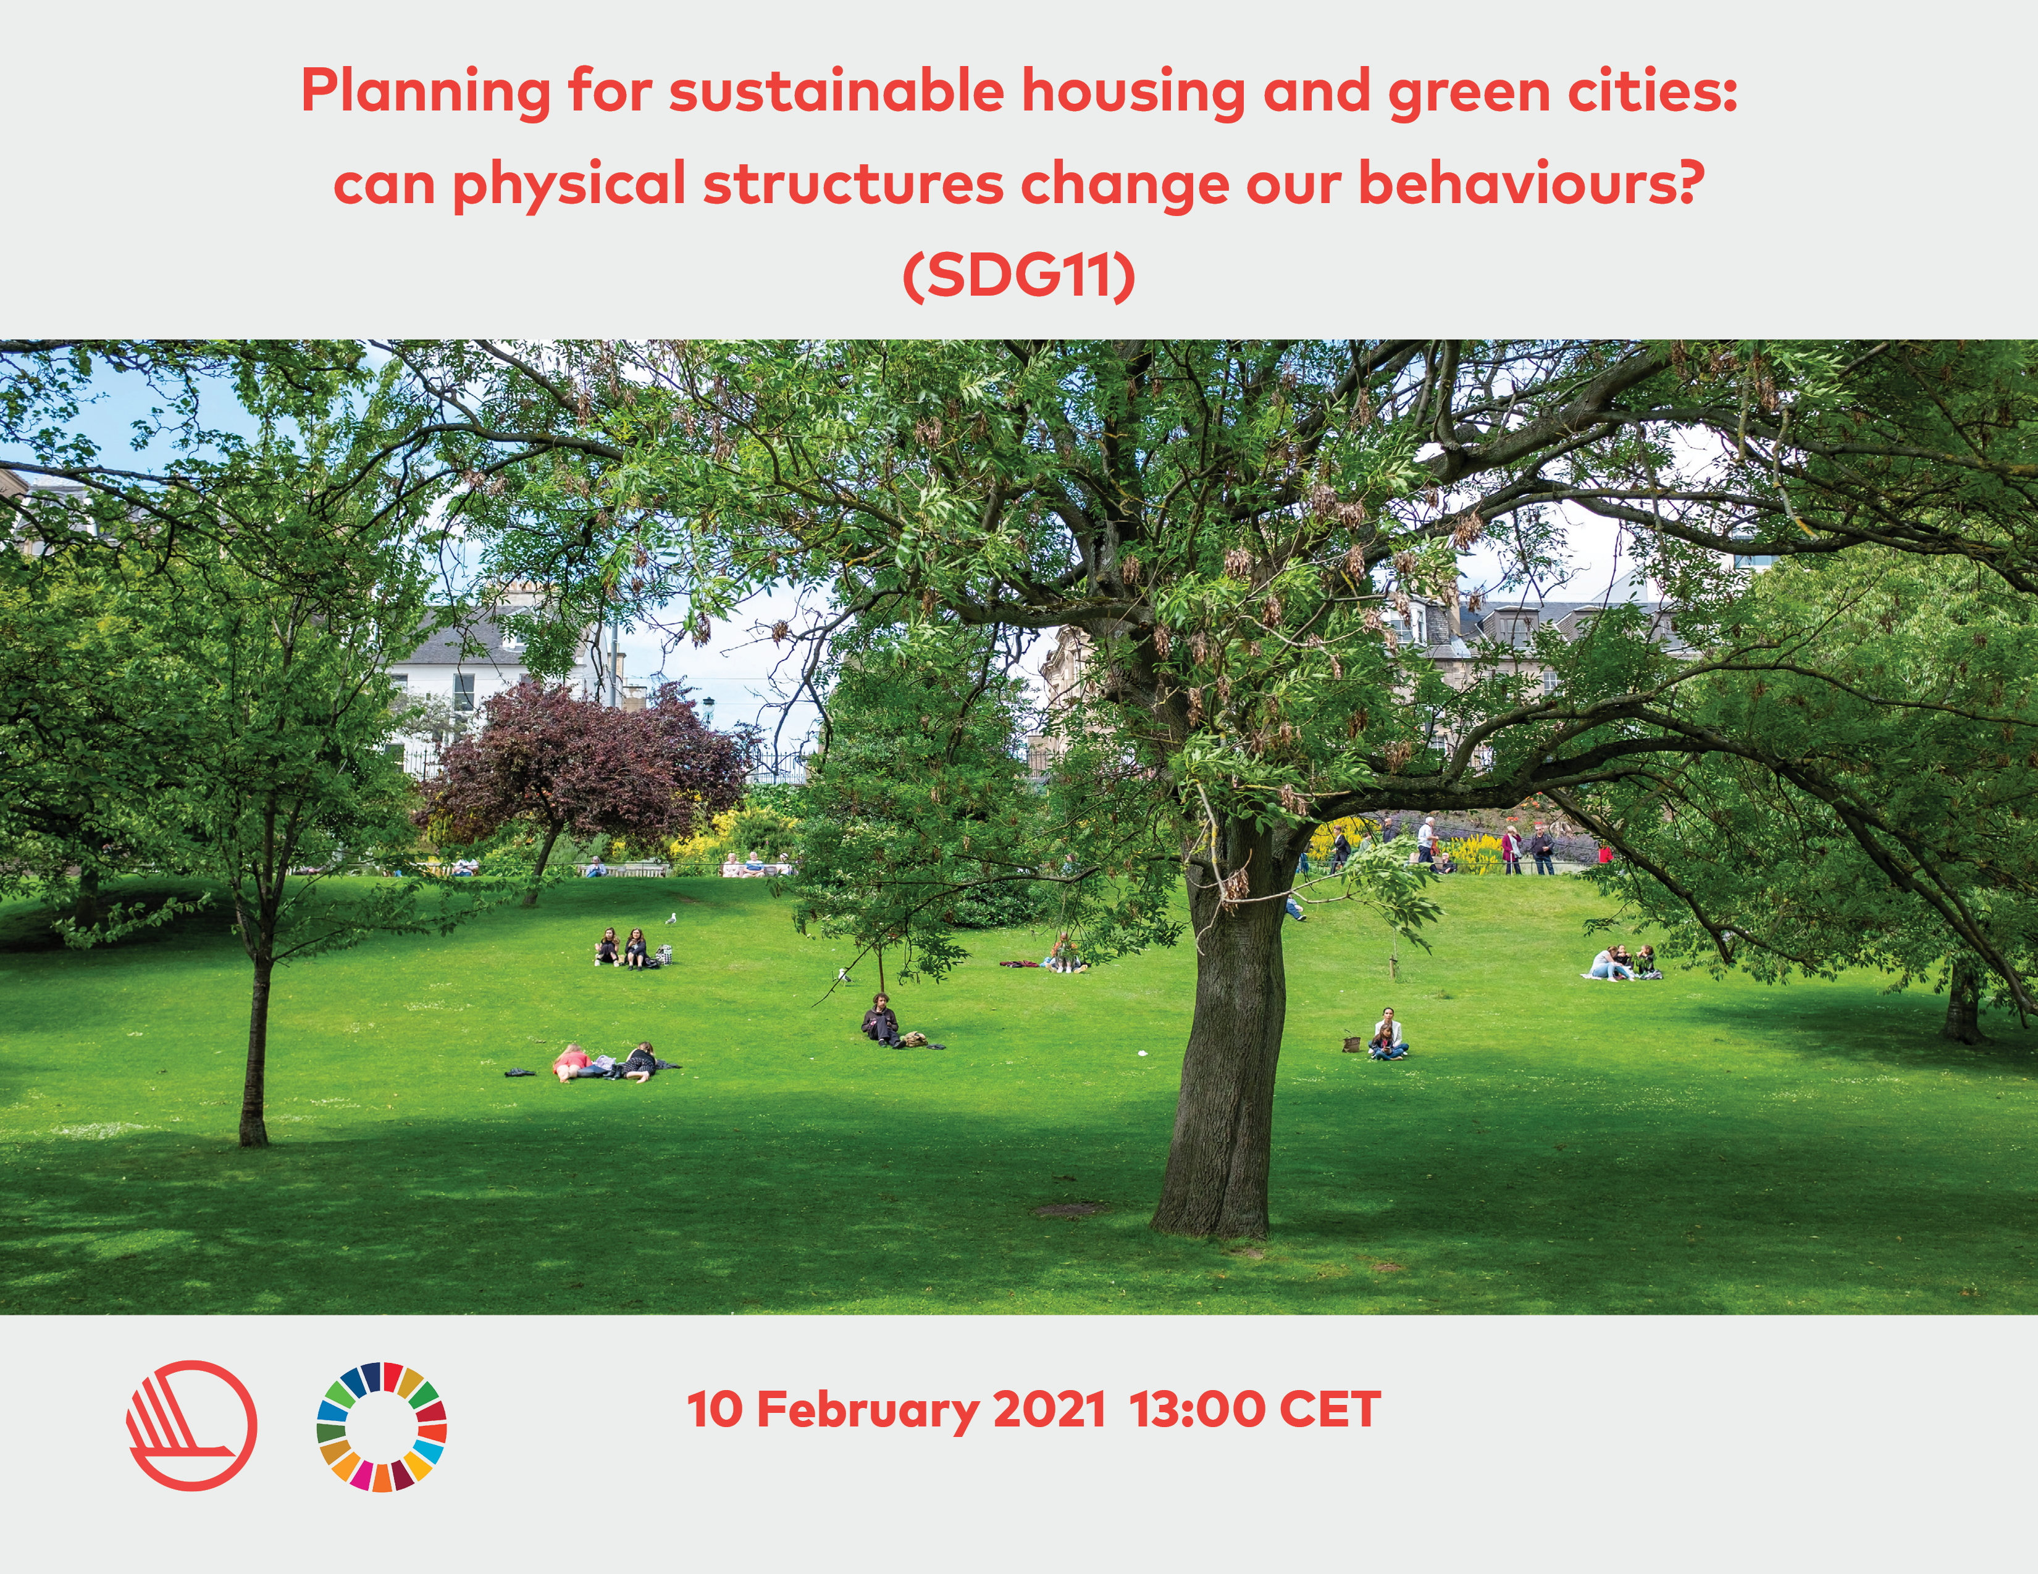

Webinars and seminars to share knowledge

