Slide 1
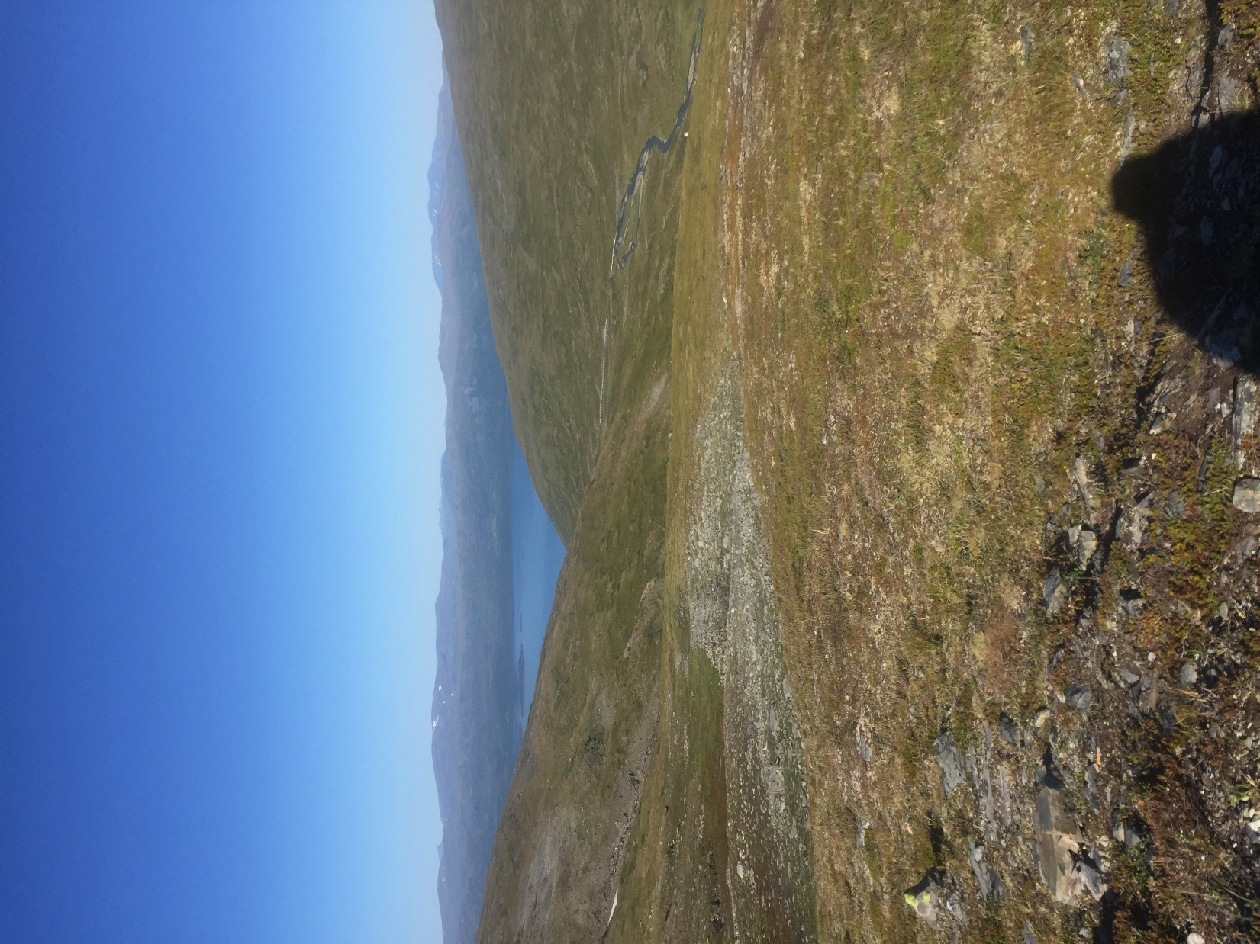
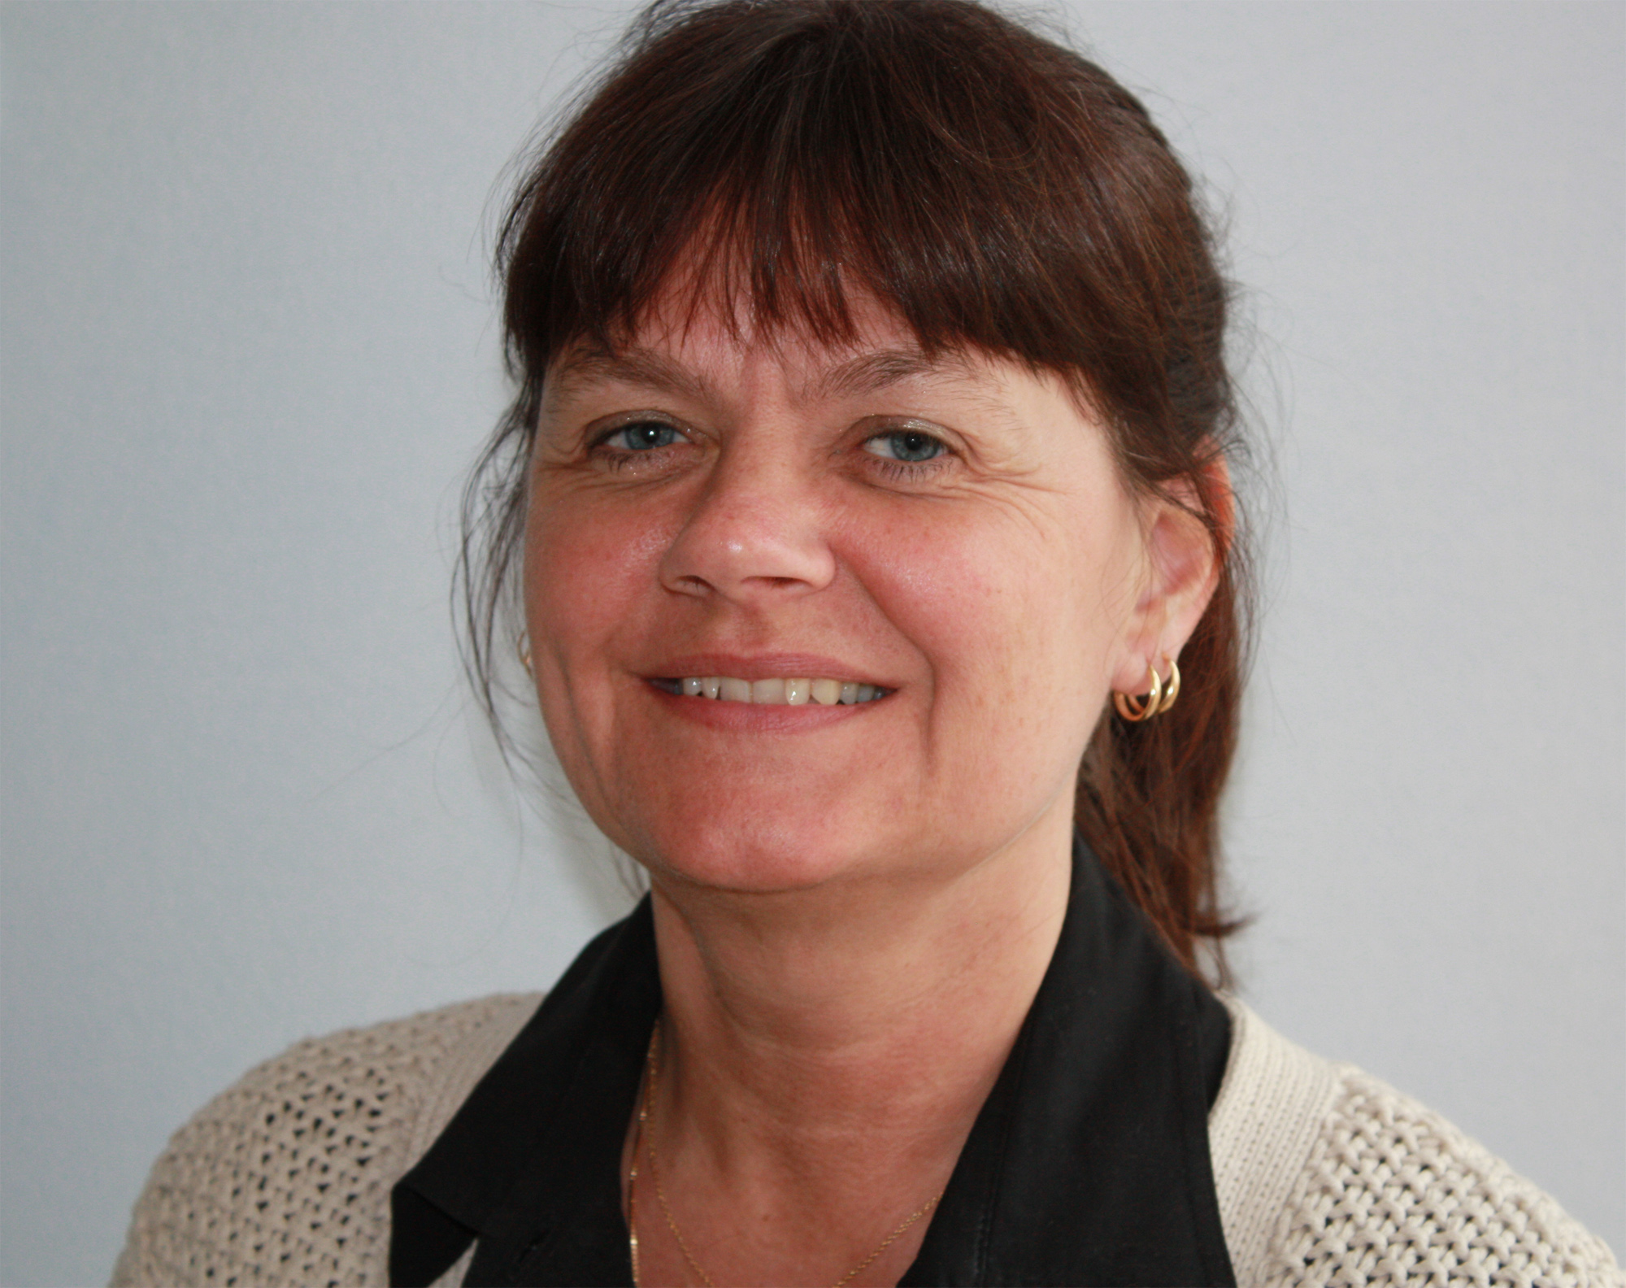
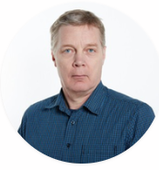
Citizen participation
in Sweden
Mrs Lena Langlet
Head of democracy
SALAR
lena.langlet@skl.se
Mr Anders Nordh
Project manager
SALAR
anders.nordh@skl.se

Slide 2

Why now?
Research
Changed roles
Dialogue into steering process

Slide 3
Why now?

Slide 4
We pride ourselves with a high turn out

Slide 5
But! – constituency 2018 (2014)
Kommun | Valdistrikt med högst valdeltagande | Valdistrikt med lägst valdeltagande | Differens
Göteborg | 94,0 (92,6) | 41,2 (37,4) | 52,9 (55,2)
Stockholm | 95,7 (94,8) | 45,7 (40,8) | 50 (54,0)
Södertälje | 86,9 (86,8) | 37,7 (42,5) | 49,2 (44,3)
Huddinge | 90,8 (91,9) | 43,2 (46,1) | 47,6 (45,8)
Malmö | 94,2 (93,4) | 49,9 (39,7) | 44,2 (53,7)
Uppsala | 94,1 (93,8) | 51,4 (57,7) | 42,8 (36,1)
Haninge | 88,0 (89,8) | 45,3 (44,6) | 42,7 (45,2)
Borås | 94,6 (92,5) | 52,7 (50,5) | 41,9 (42,0)
Botkyrka | 90,1 (90,9) | 49,0 (42,3) | 41,1 (48,6)
Sigtuna | 88,3 (85,4) | 50,0 (52,7) | 38,3 (32,7)
Notes:
Men även om valdeltagandet är högt är skillnaderna i valdeltagande stora inom kommunerna. Störst är skillnaderna i de stora städerna och i förorter med många invånare. Valdeltagandet är lägst i socioekonomiskt svaga områden och högst i socioekonomiskt starka områden.
2018: I 190 kommuner är skillnaden mer än 10 procent. I 29 kommuner är skillnaden större än 30 procent.
2014: I 198 kommuner är skillnaden mer än tio procent mellan valdistriktet med det högsta och med det lägsta valdeltagandet och i vissa kommuner till och med över 50 procents differens.

Slide 6
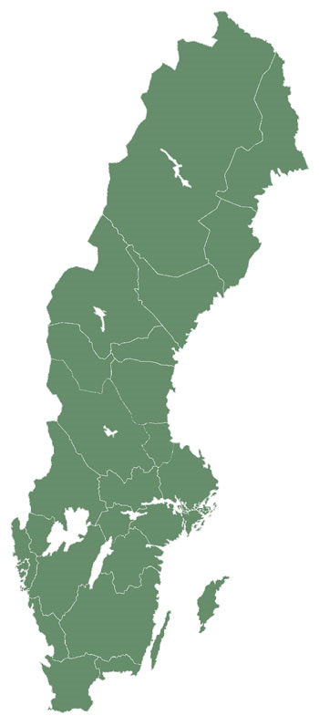
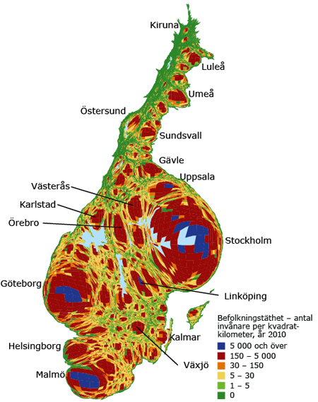
Urbanization
Original: https://www.scb.se/sv_/Hitta-statistik/Artiklar/Varannan-svensk-bor-nara-havet/

Slide 7
Two assignments focusing on trust in the democratic system
Democracy Actor
Learning
Legitimacy
Understanding of priorities
Transparency
Service Operator
Providing services
Distribute resources
Follow up on quality
Requirements switch
Notes:
Eventuellt fyra syften

Slide 8
Three challenges we know
Globalization
Increased mobility, increased contact surfaces
Economy-east / south / BRICs
Society's increased diversity and
people's varying
socio-economic conditions
in an increasingly intertwined world
brings challenges to social trust and social sustainability at the local level
Transnationell
migration
People in transit - with their everyday life
in several places at the same time
Urbanization
The increasing role of cities
The pace, the gaps and the
the changing geography of misery

Slide 9
Research

Slide 10
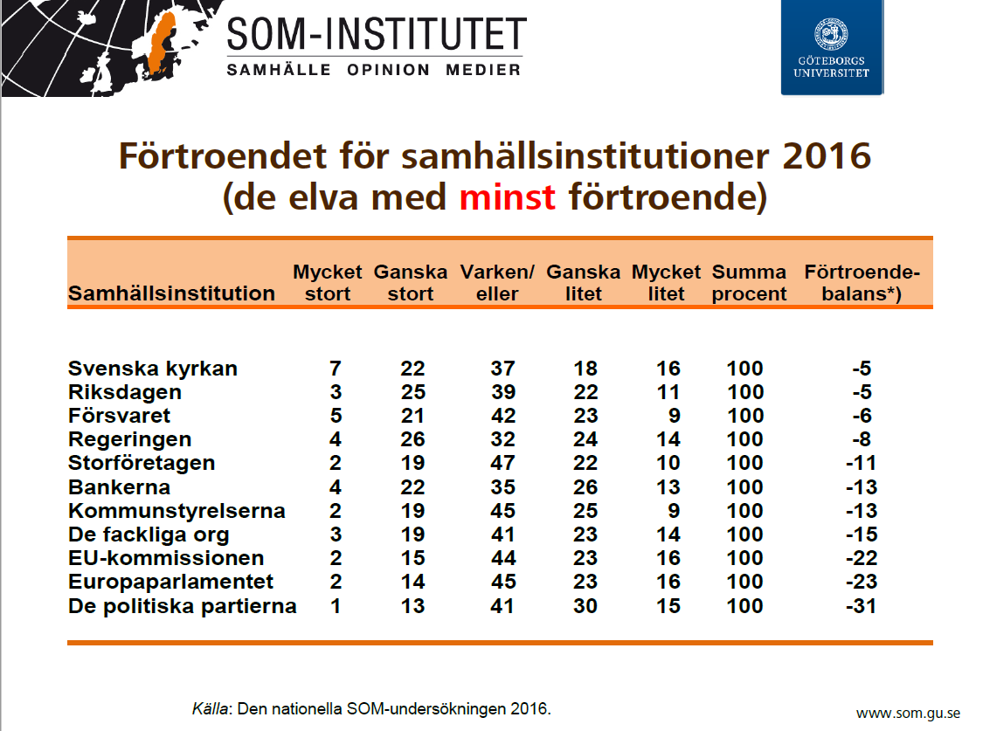
Democratic systems with low legitimicy

Slide 11
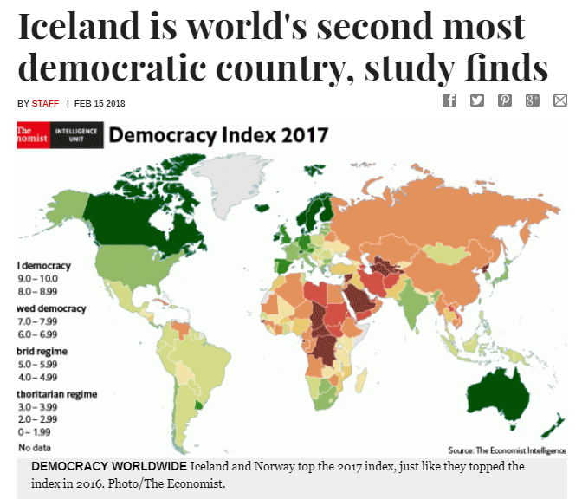

Slide 12
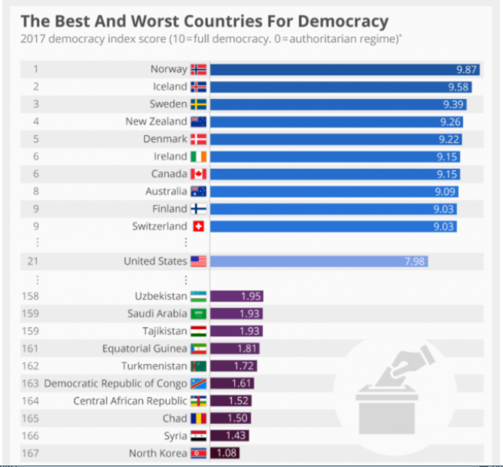

Slide 13
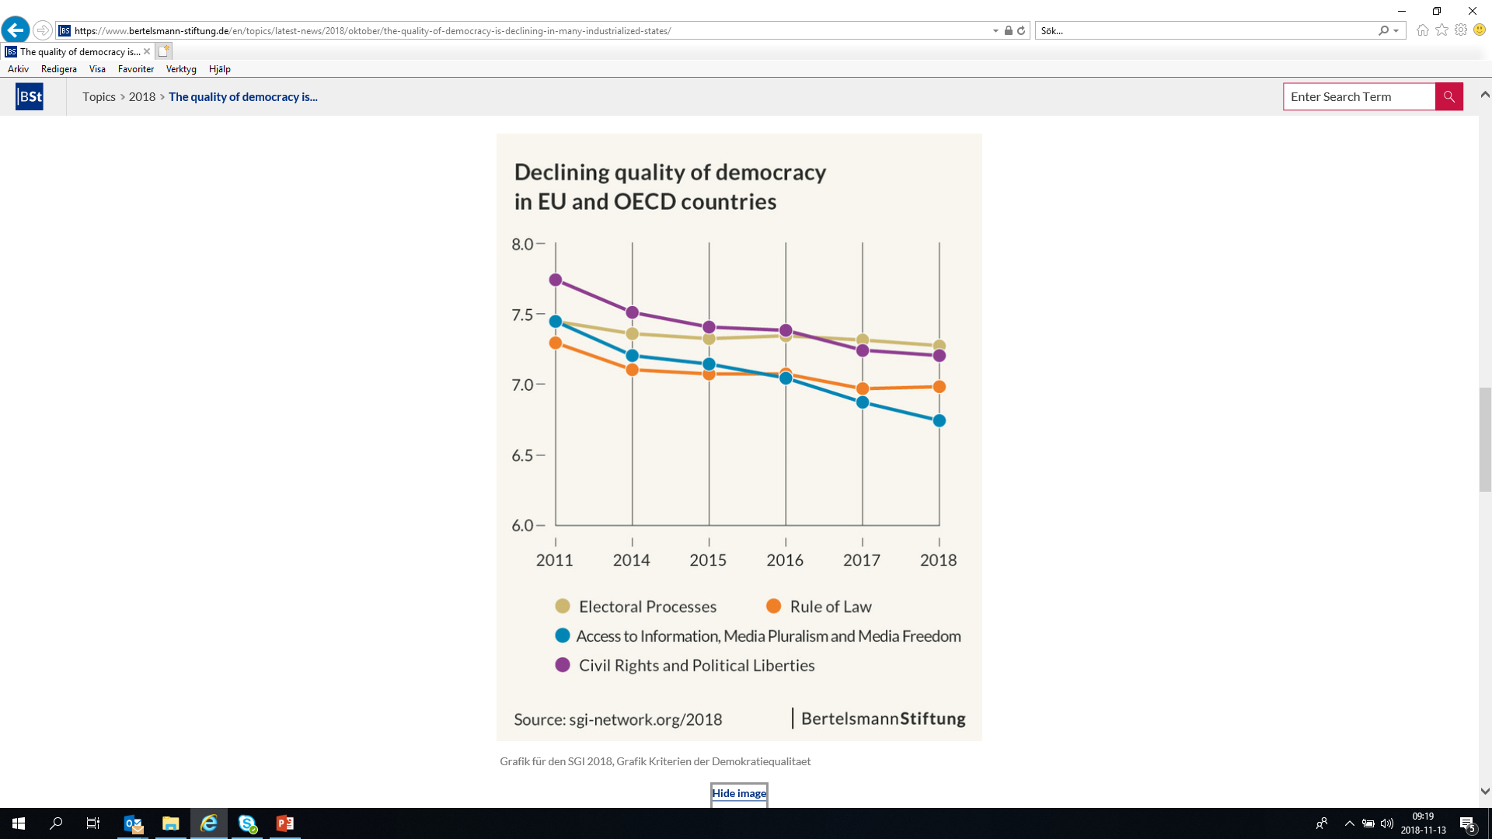
Bertelsmanns demokratiindex

Slide 14
Changed roles

Slide 15

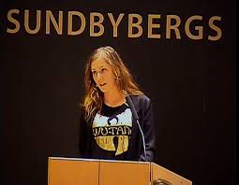
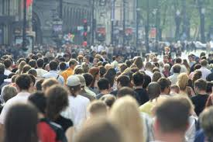
4%
1%
95%

Slide 16
Different roles
(s)
(v)
Council
Citizens
(mp)
(m)
(fp)
Users
(kd)
Staff/Office
(c)
(sd)

Slide 17
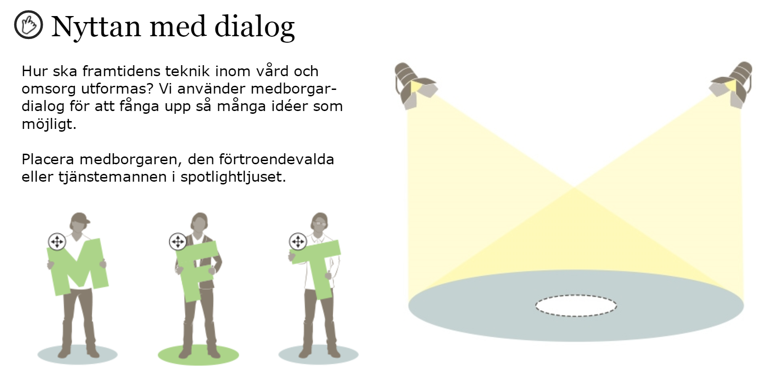
What are the benefits of citizen dialogue for different groups?

Slide 18
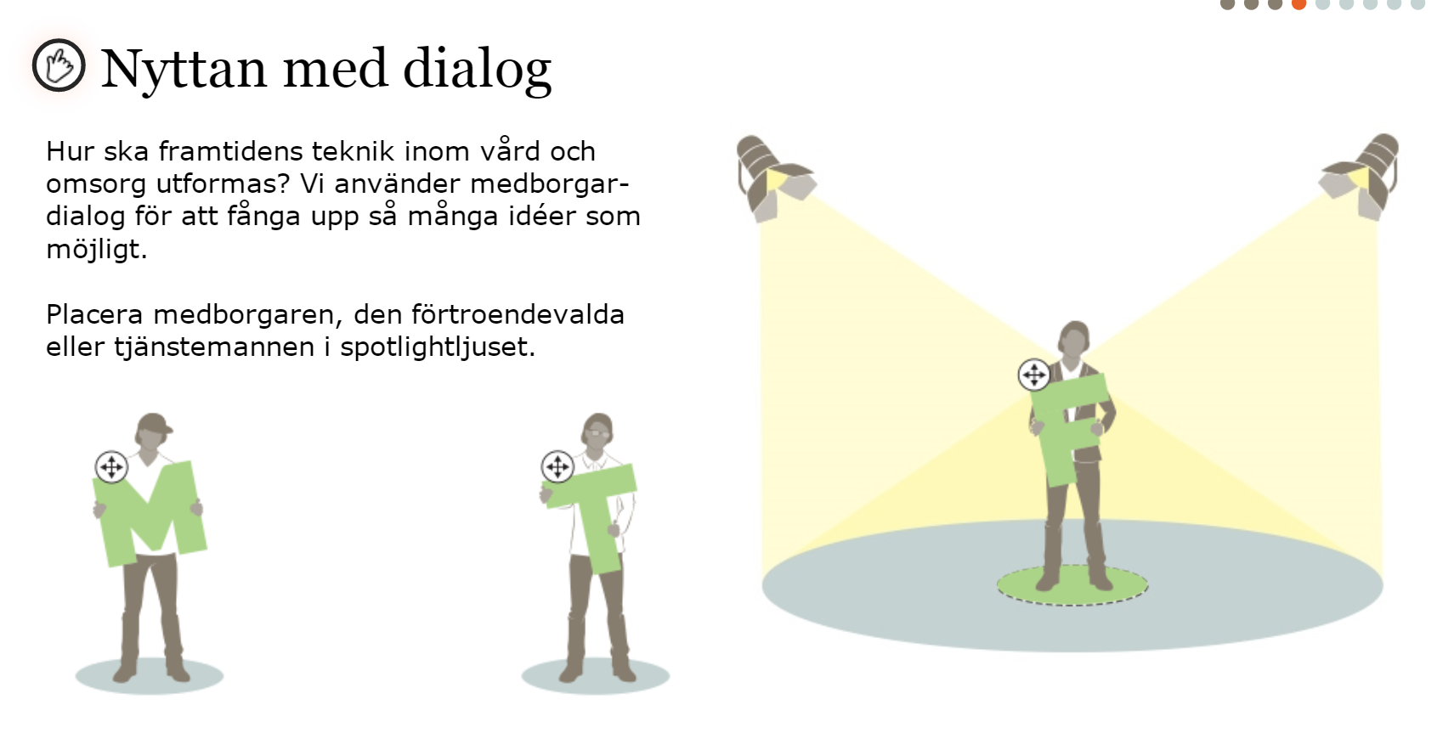
For me as an elected representative, dialogue with citizens is very important.
It provides a broader and deeper foundation for future decisions.

Slide 19
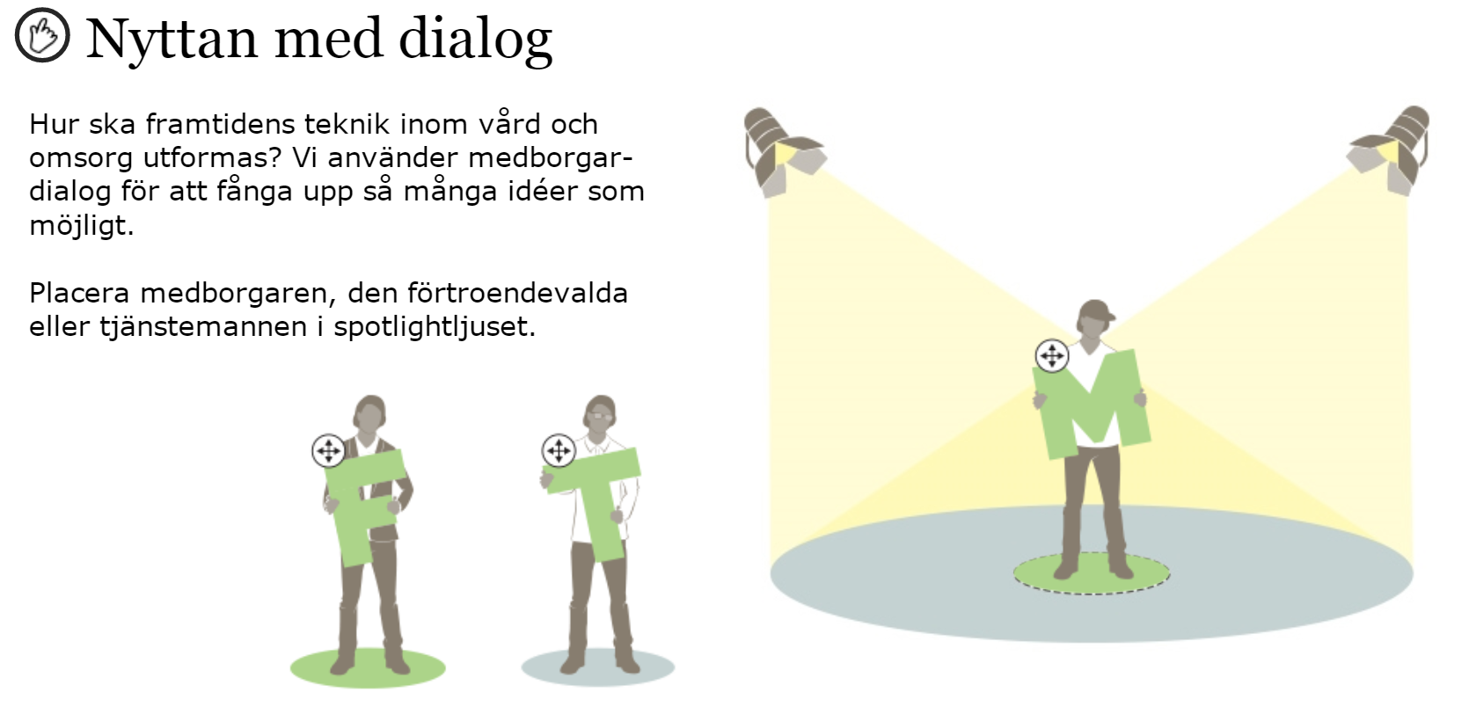
For me as a citizen, the dialogue is very interesting.
I receive information and have the opportunity to present my views and propose solutions.

Slide 20
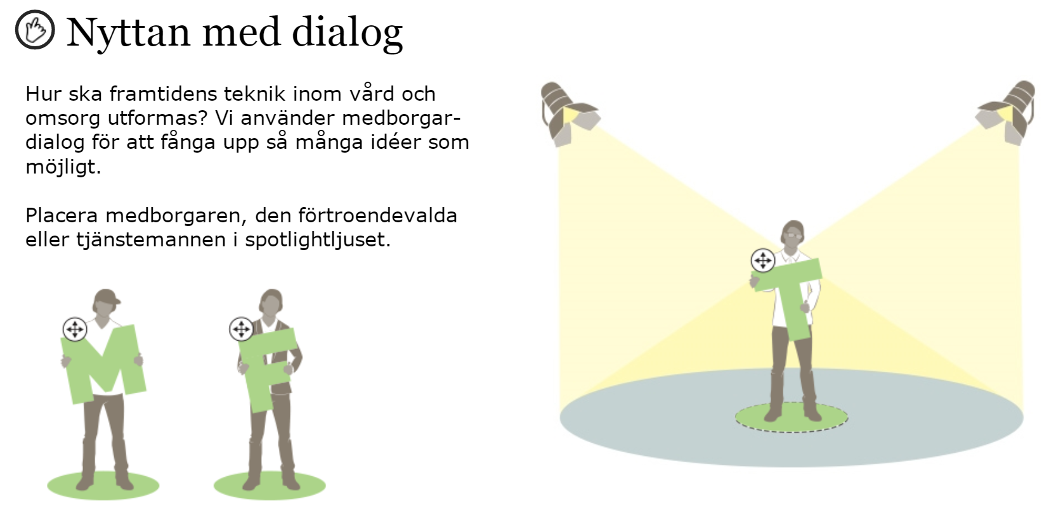
As an official responsible for investigating the issue, the dialogue with the citizens is central.
It means that we get the views and knowledge of the citizens that must be weighed and analyzed in the basis for decisions.

Slide 21

What do you see as the benefits of involving citizens?

Slide 22
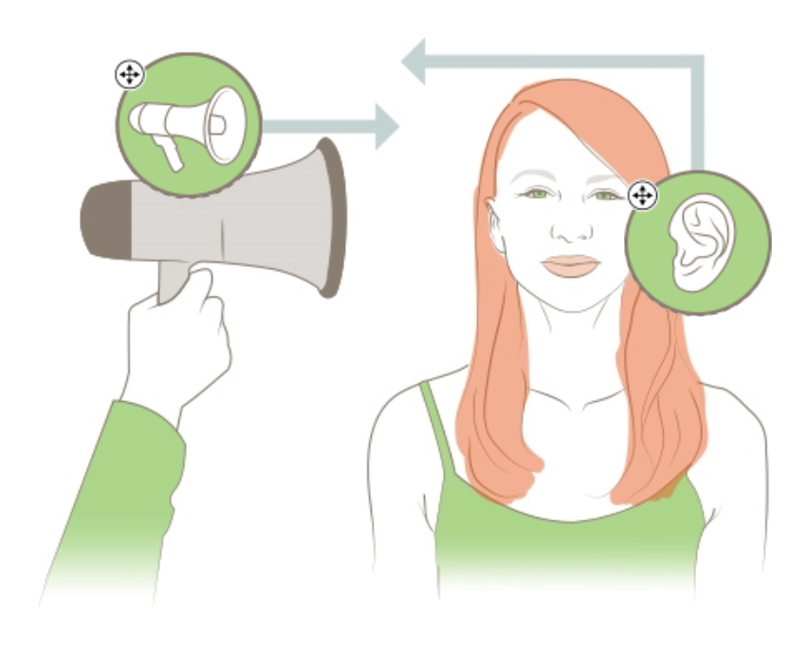
Two perspectives on communication
When communicating with citizens, you can start from two different perspectives, the sender's perspective that is based on yourself as a elected representative or official, or the recipient's perspective that comes from the citizen.

Slide 23
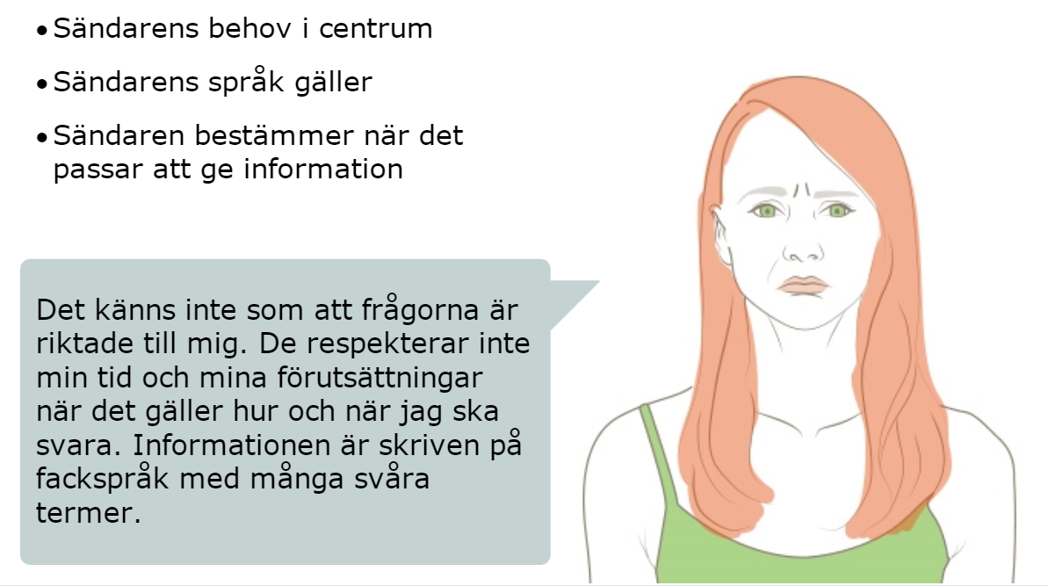
Transmitter perspective - what do I want?
Transmitter needs in the center
The sender's language applies
The transmitter determines when it is appropriate to provide information
It doesn't feel like the questions are addressed to me. They do not respect my time and my circumstances when it comes to how and when to answer.
The information is written in professional language with many difficult terms.

Slide 24
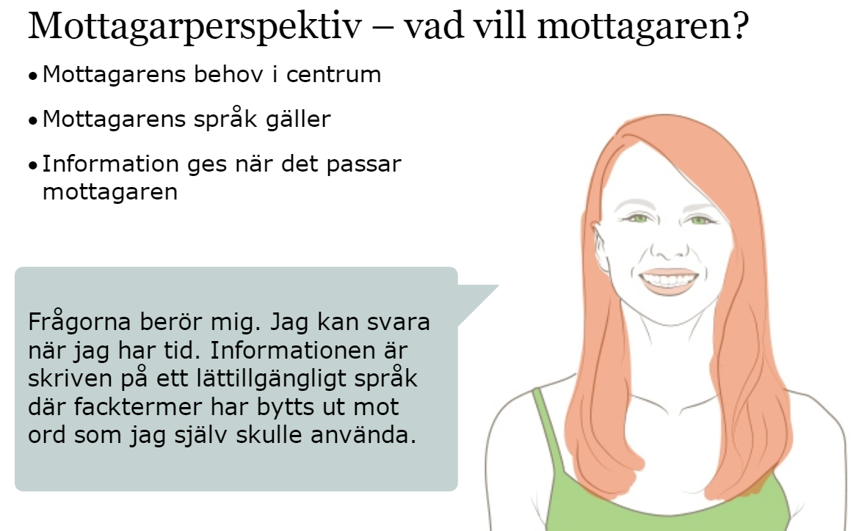
The recipient perspective - what does the recipient want?
The needs of the recipient in the center
The recipient's language applies
Information is provided when it suits the recipient
The questions concern me. I can answer when I have time.
The information is written in an easily accessible language where subject terms have been exchanged for words that I would use myself.

Slide 25
STUKTUR
CULTURE
GOAL
STRATEGY
STRUCTURE

Slide 26
Dialogue into the
steering process

Slide 27
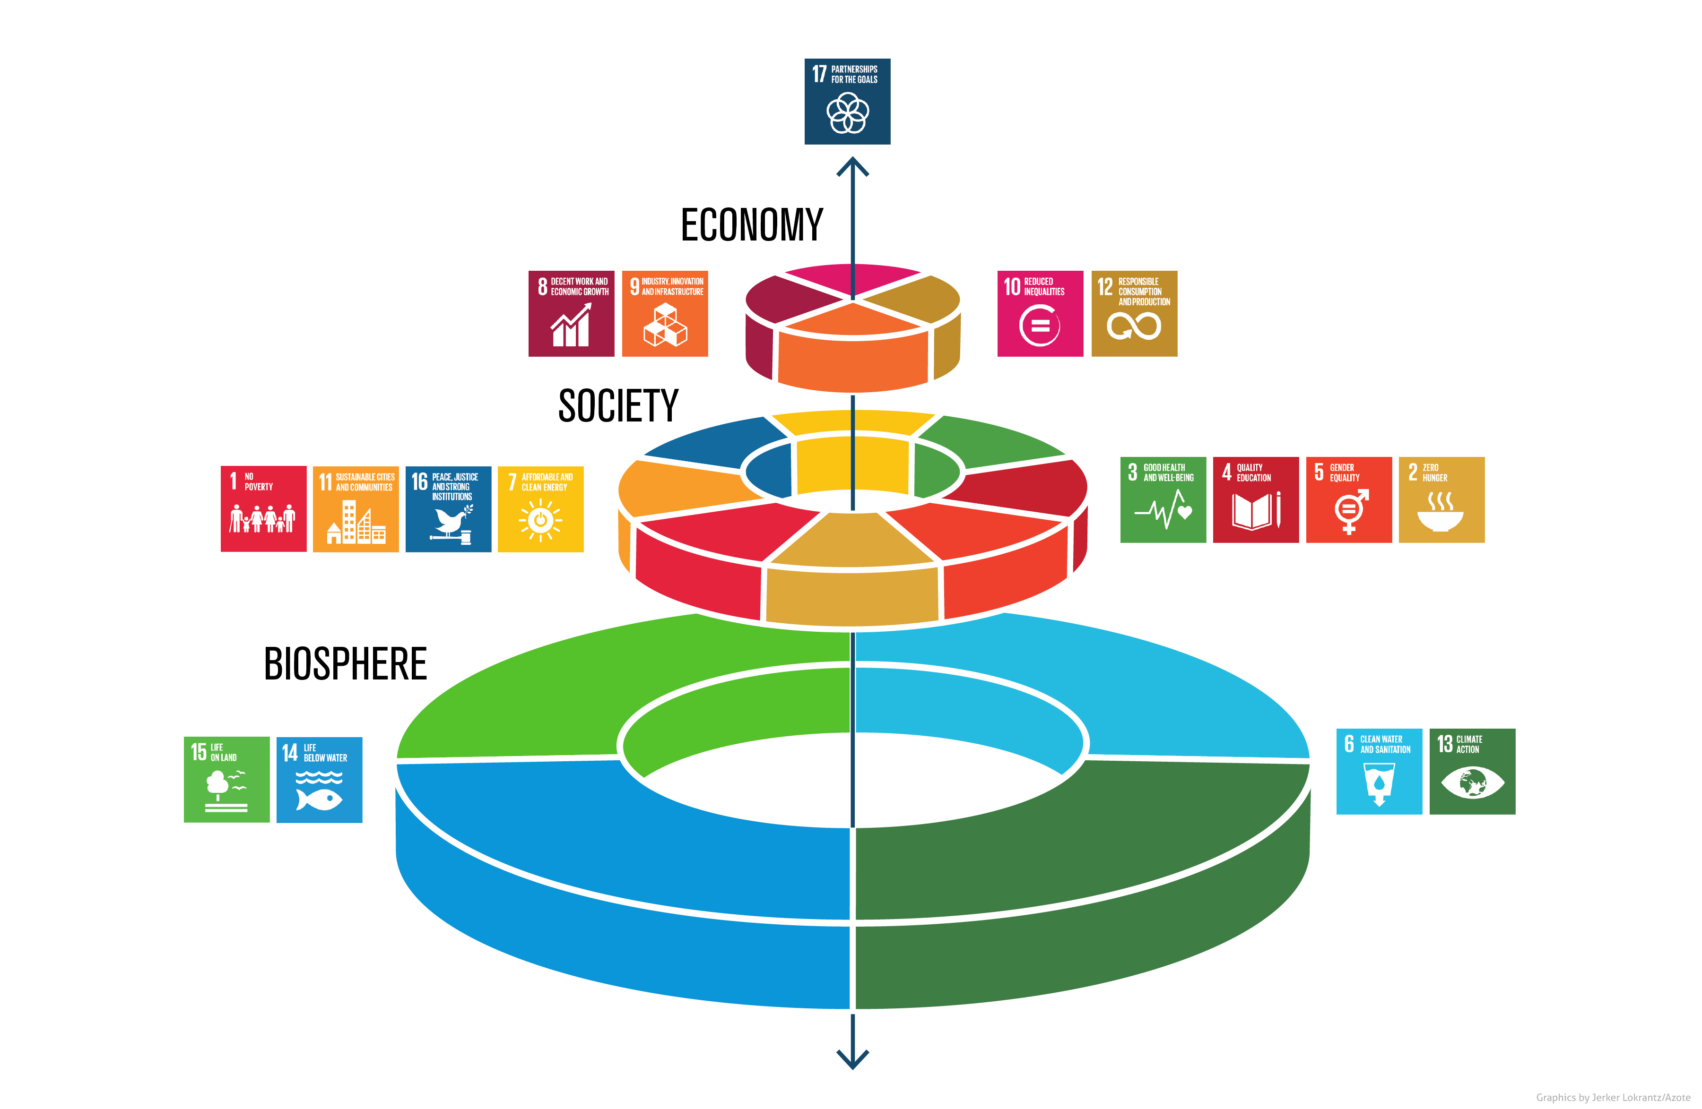
SDG

Slide 28





SALAR Congress 2015
”SALAR will support it´s members in the work to develop the dialogue and co-creation with citizens and to integrate the results in governance processes and business development for a socially sustainable society”

Slide 29

Europarådet
Additional protocol on the European
Charter of Local Self-Government
on the right to participate in the affairs
of a local authority
1 september 1988
Utrecht, 16.XI.2009

Slide 30
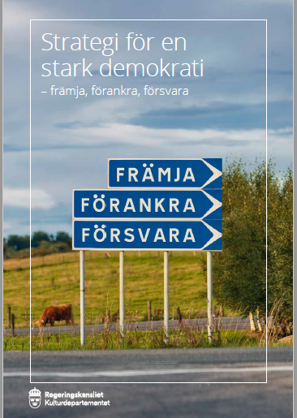
National democracy goals
The government's democracy policy goal is a vibrant democracy that is enduring, characterized by participation and where the opportunities for influence are equal
(prop. 2017/18:1, UO 1).
The government pursues a democracy policy to preserve the forces, address the shortcomings and counter the challenges

Slide 31
What goals does Iceland have?

Slide 32
The Old Governance Map
Efficiency
Principles
Results
Governance process
Democracy
Dialogue process
Organisation
Communication process
Evaluation process

Slide 33
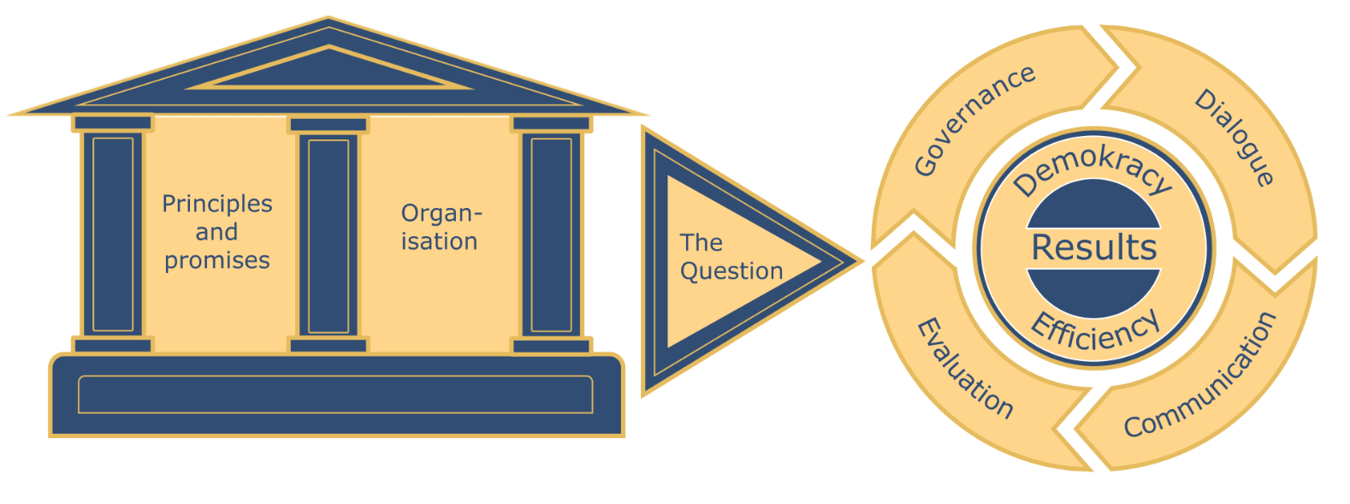
Citizen dialogue into the steering process

Slide 34
How to plan for dialogue
The question of dialogue
Target groups
Purpose
Evaluation
Local context
Level of influence
Info
Feedback

Slide 35
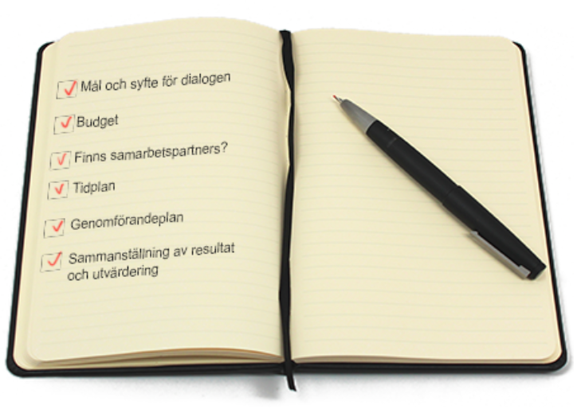
Project plan
Develop issues for the dialogue that correspond to the goal of the dialogue
Do stakeholders analysis
Determine the degree of influence for the participants
Choose methods for the dialogue
Calculate budget
Design timeline
Appoint responsible for the various steps
Establish a communication plan
Find a suitable form of documentation
Decide how follow-up and evaluate

Slide 36
Citizen dialogue into the steering process

Slide 37
Charter/Principles
Internal
structure
Internal with promesis
Cooperation
Lead by citizens

Slide 38
Organization
Process leader
Working group
Steering group

Slide 39

What do you have in place in your municipalities today?
Principles and organization

Slide 40
Questions that require a YES
Is it possible to affect the issue?
2. Am I / are we willing to be influenced?

Slide 41
Institutions
What room do the formal rules provide for citizen dialogue?
What room do informal norms and practices provide for citizen dialogue?
What resources exist for citizen dialogue and related activities?

Slide 42
Actors
Who are the most important actors in this area?
What views to the key actors have on the problems and solutions?
What power, competencies and relationships do the important actors have?

Slide 43
Power With
We decide – Citizens deliver
We co-create solutions together
Distant
Close
We invite partici-pation, on our terms
We decide
Power Over

Slide 44
Dialogue at different stages
Needs
Evaluation
Solutions
Implem-entation
Analysis
Decision

Slide 45
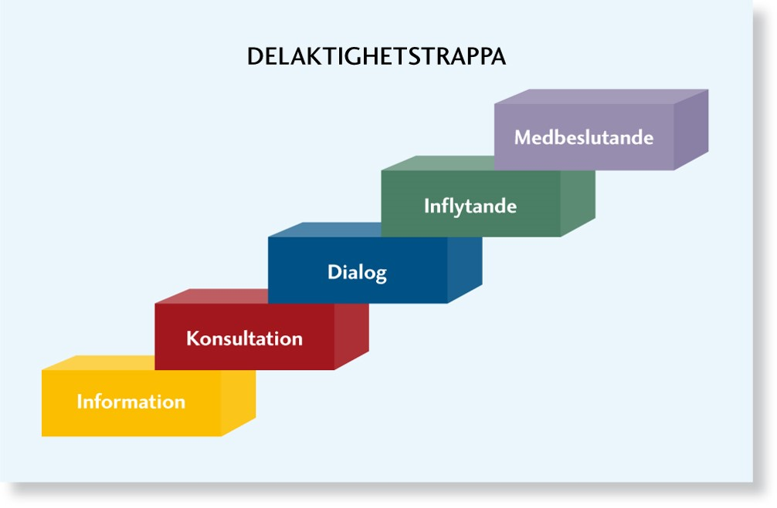





Ladder of participation

Slide 46
The road to results
Efficiency
Democracy
Goals
Resources
Process
Results

Slide 47
Different types of goals (i)
Resource goals
Make clear what goals the Municipality has for the use of resources in the citizen dialogue process.

Slide 48
Different types of goals (ii)
Process goals
Make clear what process goals exist for the citizen dialogue. Often there are quantitative measures, such as the number of participants, the gender balance, age representation etc.

Slide 49
Different types of goals (iii)
Result goals
Make clear what the intended end goal of the dialogue is. In Sweden Municipalities have mainly focussed on goals to strengthen local democracy and make public services more efficient. Result goals often include measures of participant satisfaction.

Slide 50
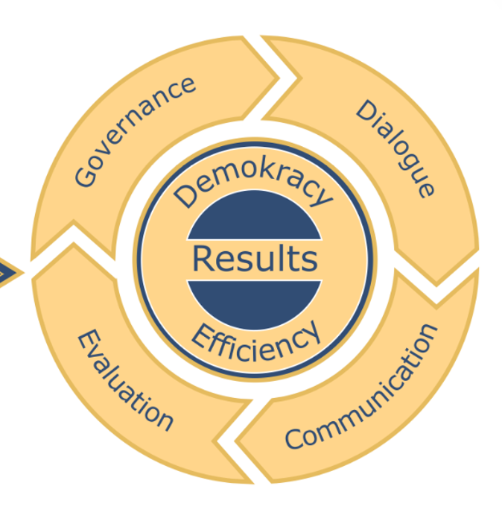
Governance - Once we have made the decision to use citizen dialogue, it is important to manage the workflow in a systematic and thoughtful way.
In this way, we enable citizens, officials and elected representatives to understand the process and what will happen to the issue in the end.

Slide 51
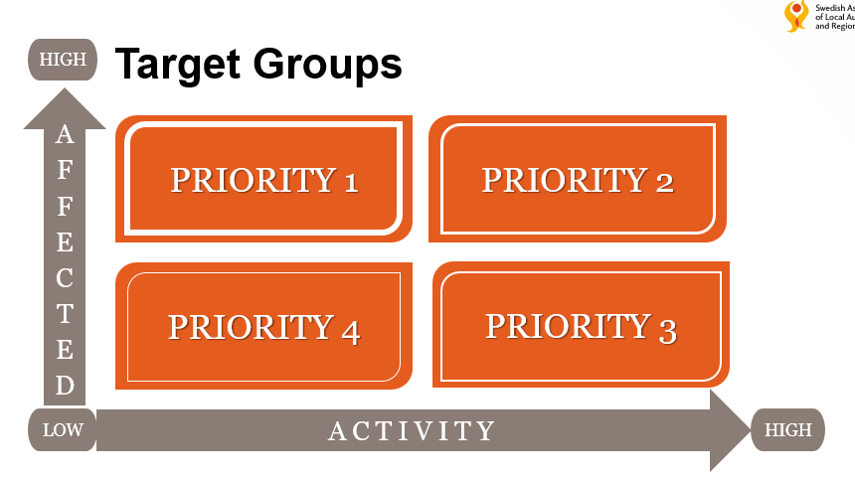
Retrieved from German researchers
You can be low or high active as a citizen, the question may concern you a little or a lot.
1- Which are the low-active people who are much affected by the issue we want to have a dialogue about?
2- which are the ones that are highly active and are greatly affected
3 - which are those that are highly active but that are not affected as much
4- which are the low active ones that are not affected so much
How do we reach the different groups? Who are they?

Slide 52
The process
Decide on
dialogue
Feedback
Political level
Decision on
actions,
feedback
Purpose and
affectability
Reconciliation
Common level
Processing
and
evaluation
Inititiativ
Implementation
Compilation
of results
Official level
Planning

Slide 53
Dialogue - Decide on the level of participation for the citizens in the dialogue and what methods we should use.

Slide 54

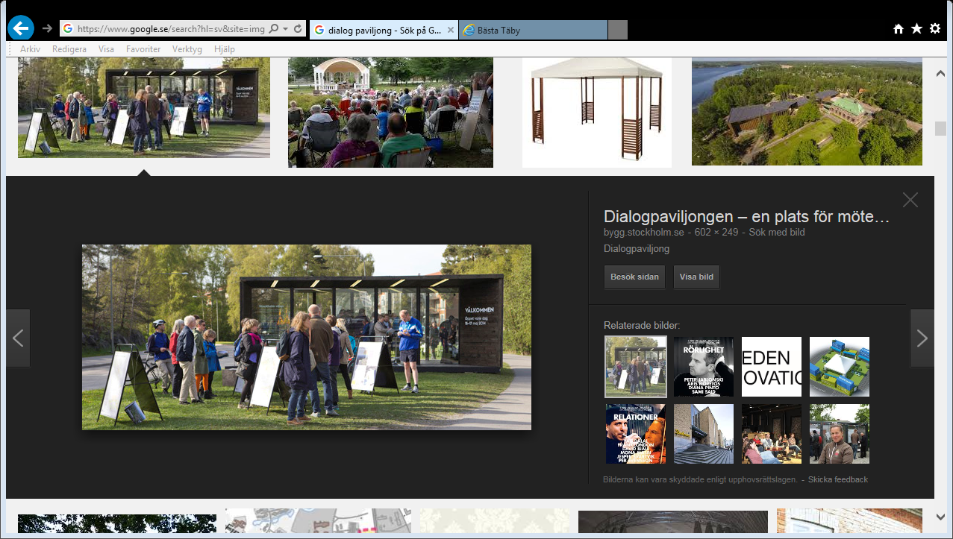
Information basis for dialogue!
Ladder of participation
Correctly
Actual
Understanable
At the right time
At the right places

Slide 55

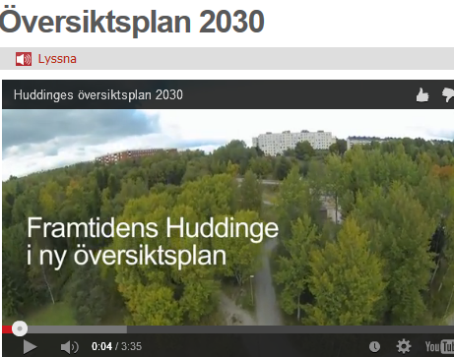


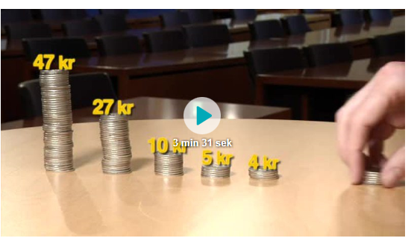
How do we inform?
Search in our diari

Slide 56
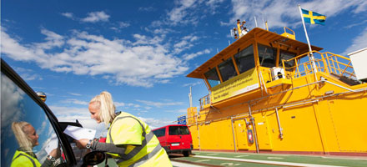
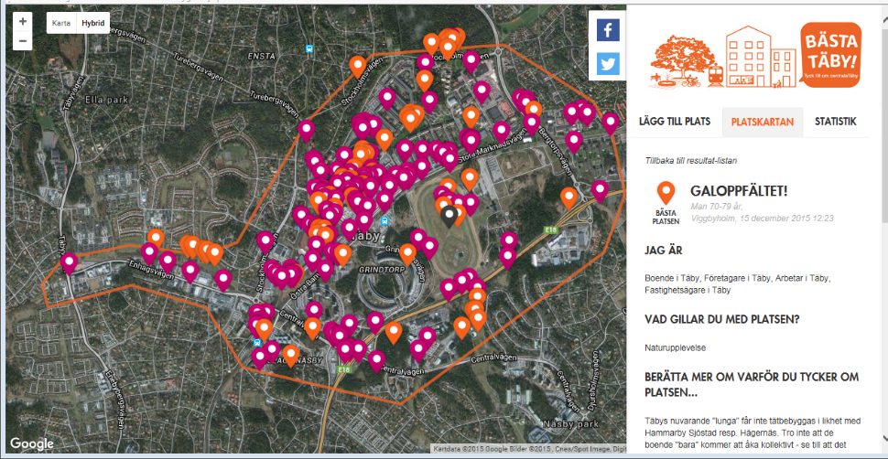
Methods and level of participation
Ladder of participation
What do we invite to
What methods do we use

Slide 57
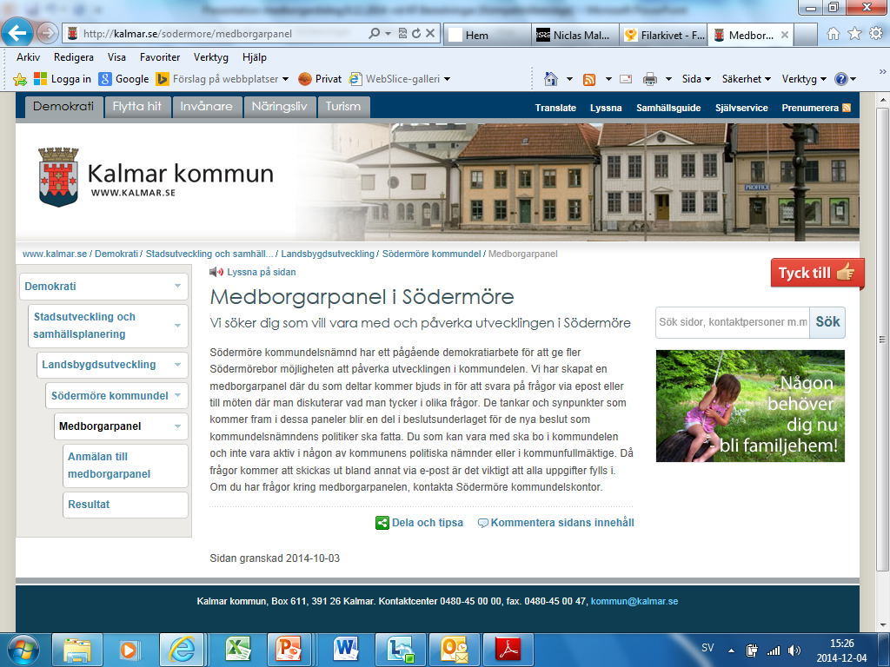
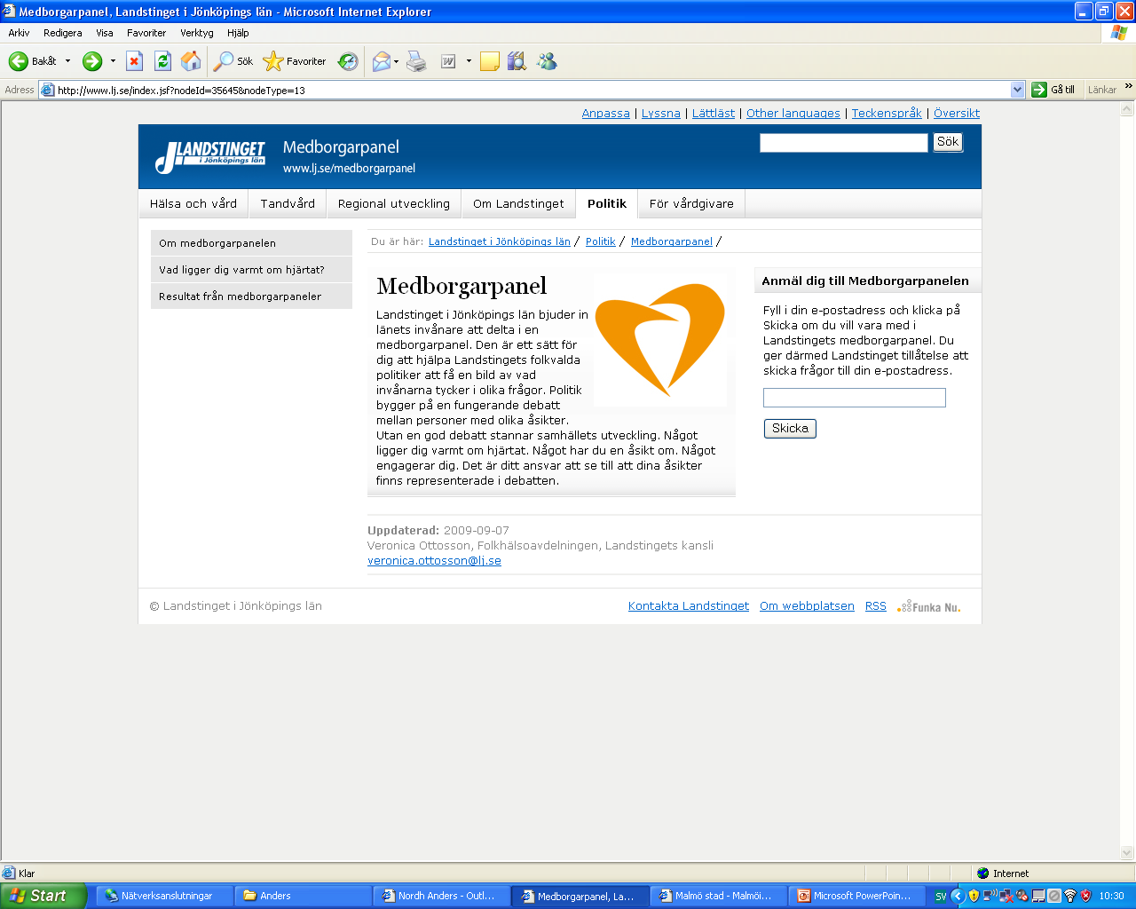
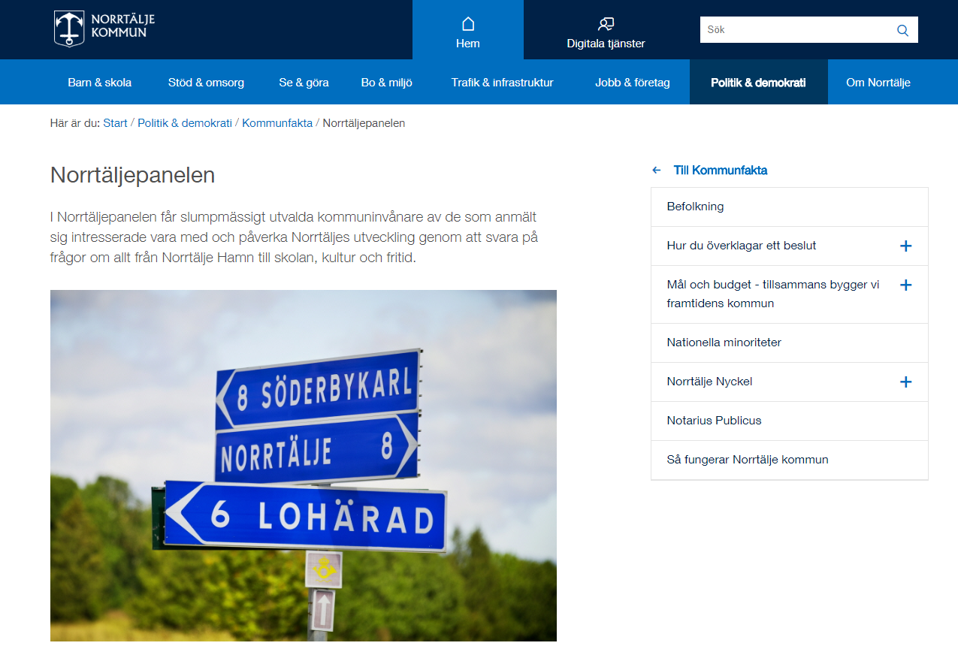
Citizen panel for consultation

Slide 58
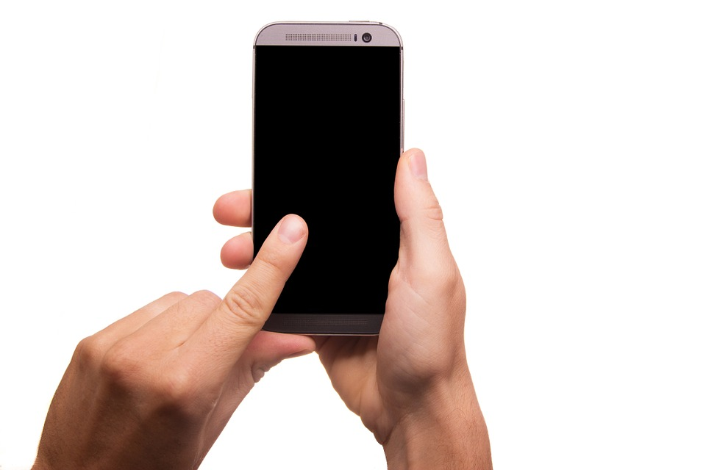
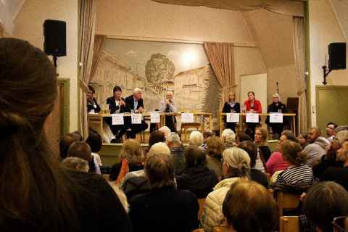

Come to the City hall next monday 19:00
What do you think?

Slide 59
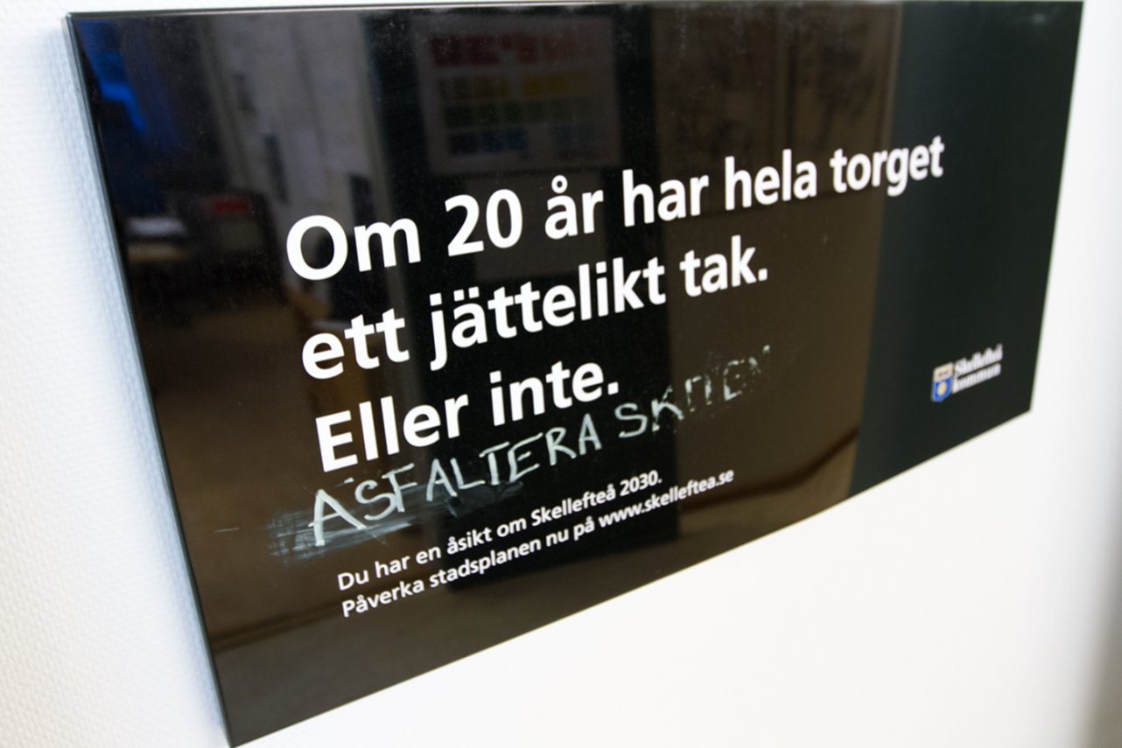
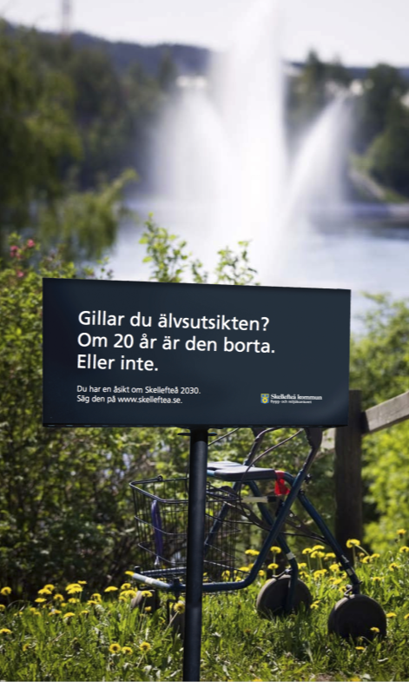
Skellefteå planning for the future
Dialogue early in the process
Dialogue with new methods
Inspiration

Slide 60
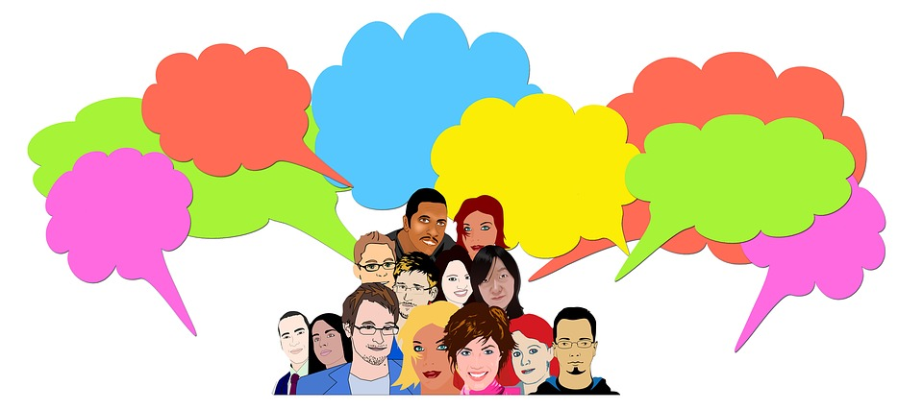
Walk and talk
Look over there
Did you see…?
I think…
It is to…

Slide 61
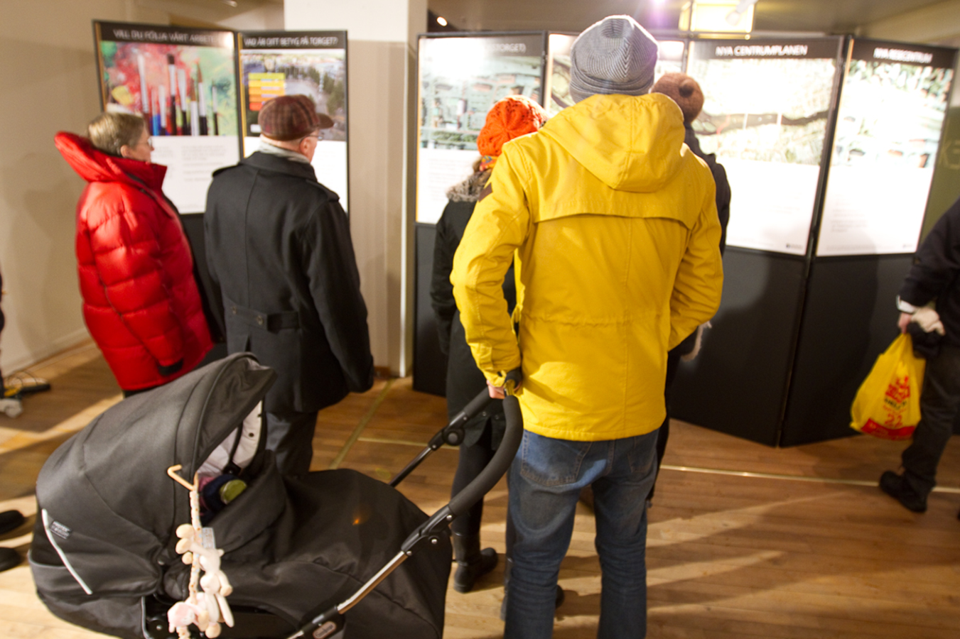
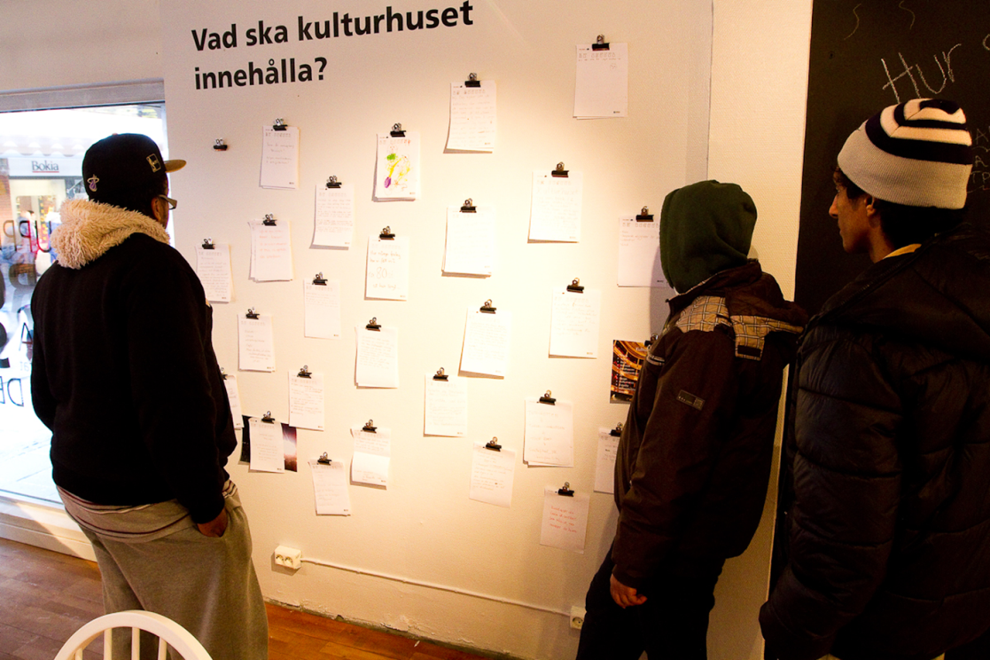
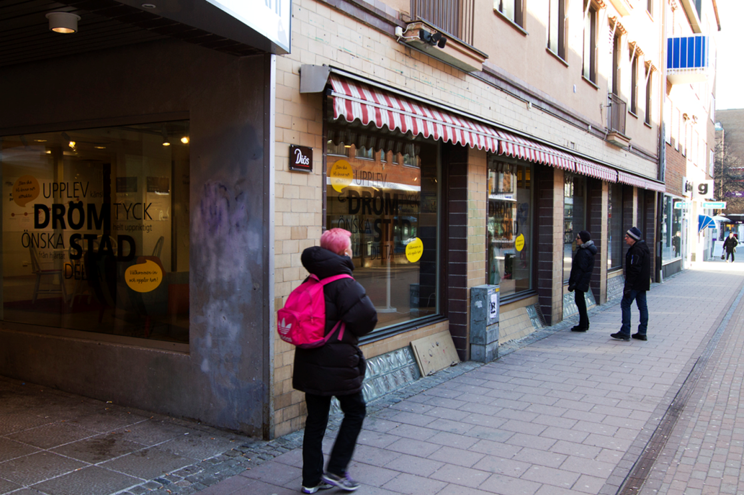
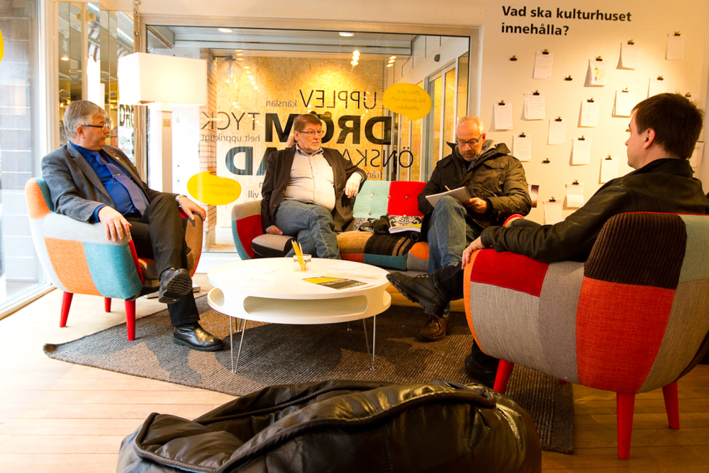
Be where the people are

Slide 62
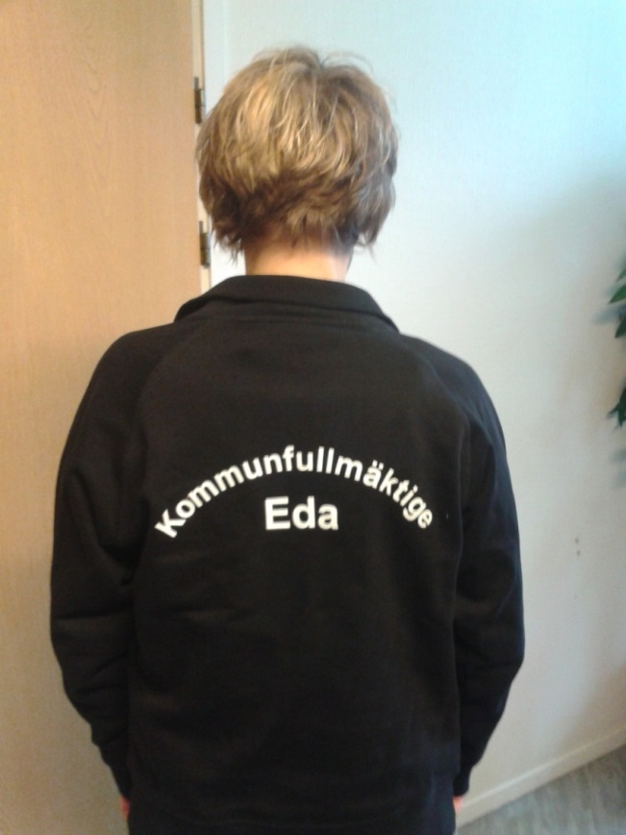
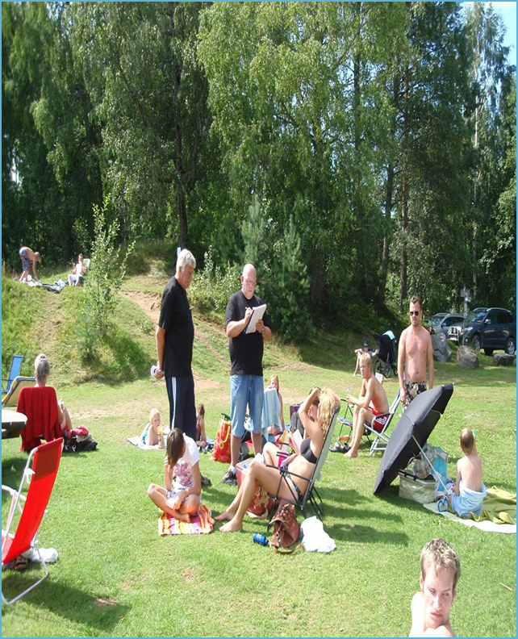
Seek for people!
We heve met and had dialogue with at least
1000 citizen
One of eight in Eda

Slide 63
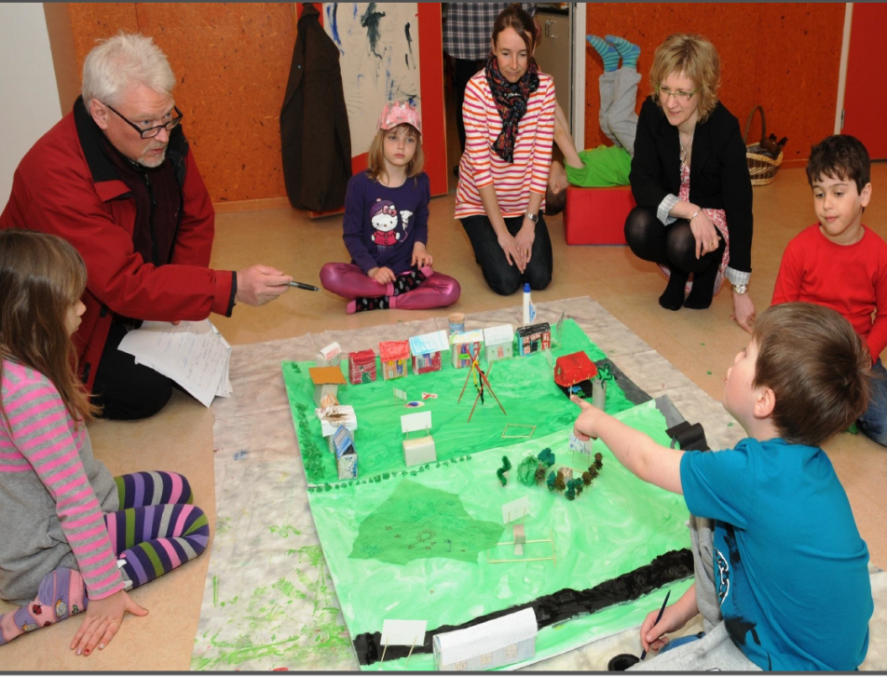
Involve children!

Slide 64
Dialogue meetings – cafe’ dialogue

Slide 65
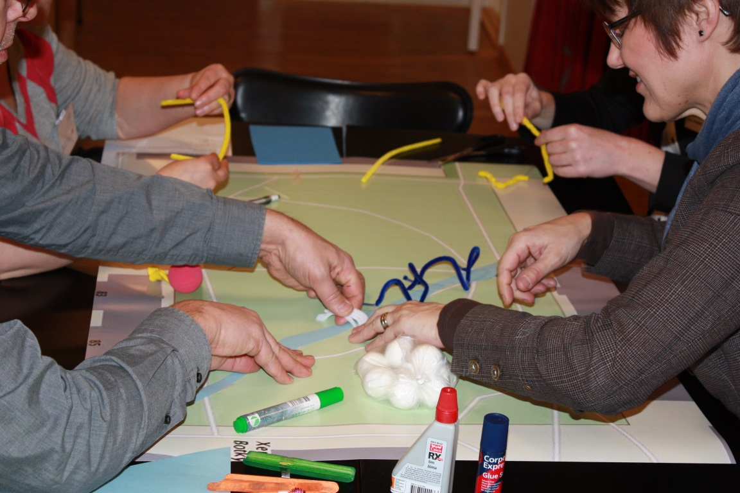
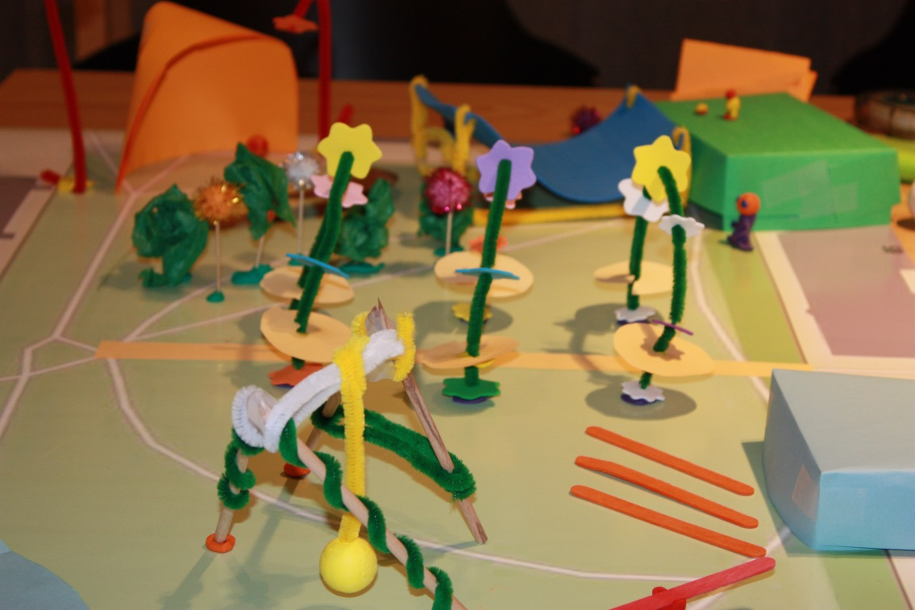
Creating the future with adults

Slide 66
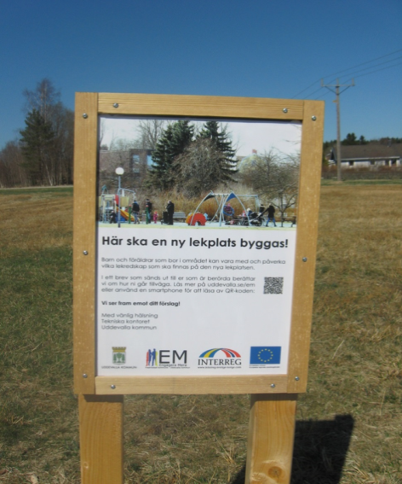
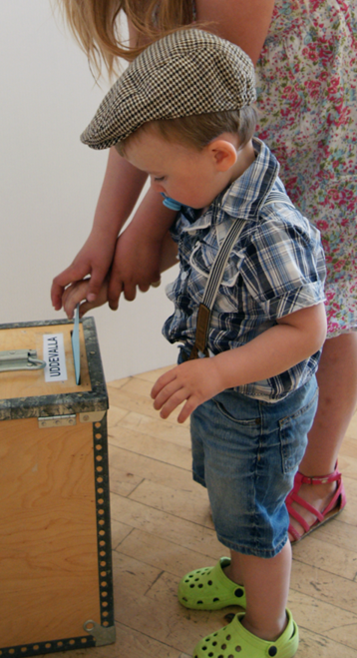
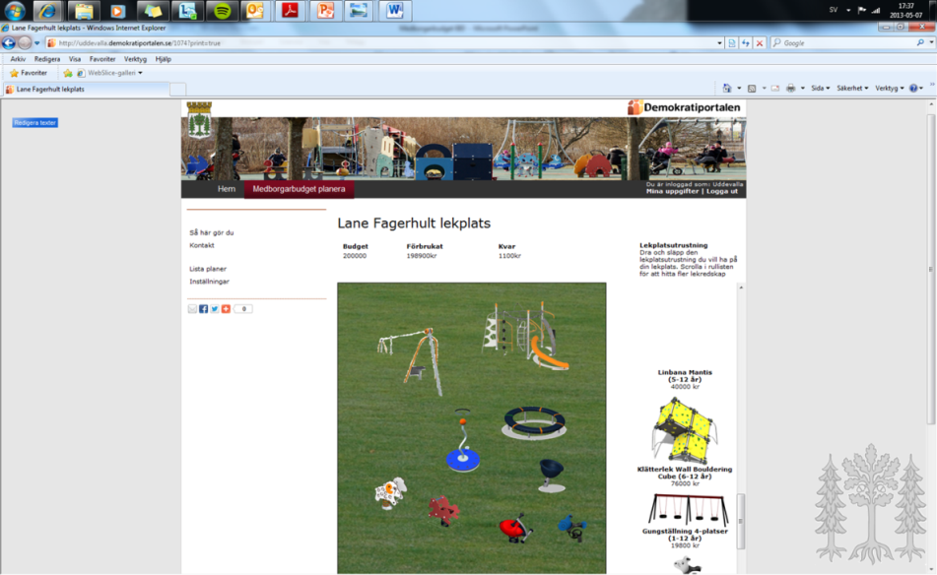
Participatory budgeting - playground
Four step
1 Webb tool to propose
2 civil servant prepare two options
3 voting
4 inauguration

Slide 67


Upplands-Väsby – Build the park of your dreams!

Slide 68
Digital or analog?
Take advantage of the best of each dialogue form - please combine
People want to participate when we go home
Some people have difficulty catching up or being able to go to a meeting because of time, distance etc.
Representativeness ?!
Regardless of the choice of method - don't forget marketing and feedback

Slide 69


Are we opening a wishing well?

Slide 70
Communication - Develop a communication strategy for what communication should look like before, during and after the citizen dialogue.
It is important that the communication is adapted to the recipient, that we capture and strengthen commitment and that we feedback the results.

Slide 71
Communication
Partici-pants
Elected politicians
Citizens
Plan
for communication:
Why?
When?
Were?
How?
Who?
Commun-ication
Civil Servants
Media
Others

Slide 72

Tydliggör vilka metoder ni behärskar och erbjuder
one-way
communication
Q and A
Newspaper, web,
print,
grand meeting
Know
poll
focus group
walk&talk
Consultation
obtaining views
Think
exchange of thoughts
recurrent
dialogue Cafe
counsel
politicians lunch
Dialogue
Reason
activities are planned and implemented
Influence
implement
safety tour
consultation
Co - desicion
joint decision
making
Participatory
Budget
Decide

Slide 73

Hear about the issue
General information Targeted info Personal impact

Slide 74

Getting interested in the issue
General information Targeted info Personal impact

Slide 75

Reads, listens more actively
General information Targeted info Personal impact

Slide 76

Feeling concerned
General information Targeted info Personal impact

Slide 77

Looking for more information
General information Targeted info Personal impact

Slide 78

Considering participation
General information Targeted info Personal impact

Slide 79

Participates
General information Targeted info Personal impact

Slide 80
Evaluation - Systematically evaluate both work processes and their results. For a successful result, we already need to decide how to do it during the planning phase.
Develop goals and indicators to compare with and allocate responsibility for managing results, monitoring and evaluation.

Slide 81

How do we take care of the dialogue outcomes?
Who does the work?
Do we need to deepen the dialogue?
Can we involve the citizens?

Slide 82

How can we involve the participants in the implementation?
The dialogue must be deepened and focus on what creates value and how it can be developed together with the residents

Slide 83

Give feedback!
What did we promise?
Visualize how the results are taken care of
Information about results
Evaluate together with citizens

Slide 84


Slide 85
Citizen participation is not……
Anchoring the decision you already made or plan to make
A happening to promote yourselves
Something you just because everybody else does it
Information in general
Something that officials fixes

